Slide 1
TEACHING DECK · FOR INSTRUCTORS
ChatGPT Referrals to E-Commerce Websites
How does organic LLM traffic (oLLM) compare against traditional digital channels? A first large-scale empirical study.
Maximilian Kaiser · Christian Schulze
Forthcoming, Marketing Science (2026) · Slides for teaching, free to use · organicllm.org
Notes:
Welcome. This deck teaches the main findings of Kaiser & Schulze, "ChatGPT Referrals to E-Commerce Websites," forthcoming in Marketing Science. It is built for an advanced audience (MBA / master's / doctoral, or executives comfortable with regression evidence) and covers the full paper — the main body (Sections 1–7) and the online appendix. Set up the spine now: organic LLM traffic is a genuinely NEW channel (it appeared in August 2024), it is still TINY, and one year in it beats only one traditional channel on conversion. The interesting story is the trajectory and the heterogeneity. All figures are the authors' own, reproduced from the paper.

Slide 2
ABOUT THE AUTHORS & THE PAPER
The authors & the paper
Maximilian Kaiser
Christian Schulze
University of Hamburg · Grips Intelligence
Frankfurt School of Finance & Management
LinkedIn
LinkedIn
Read the paper
Marketing Science (forthcoming) · organicllm.org — paper companion site
Maximilian Kaiser & Christian Schulze · ChatGPT Referrals to E-Commerce Websites · Marketing Science · organicllm.org
2
Notes:
Maximilian Kaiser is at the University of Hamburg and Grips Intelligence (the market-intelligence firm that provided the proprietary first-party data). Christian Schulze is at Frankfurt School of Finance & Management. The paper is forthcoming in Marketing Science; the freely downloadable preprint was a top-download paper on SSRN in 2025. The companion site, organicllm.org, bundles the open-access paper, the press coverage, and the latest version of these slides. Disclosure worth stating to students: the data came from Grips Intelligence, but the firm had no role in the research questions, analysis, or interpretation, and does not benefit from making any platform look better or worse. Encourage students to read the open paper and connect with the authors.

Slide 3
ORIENTATION
How to use this deck
Scope: the full paper — the main body (Sections 1–7) and the online appendix (after Section 7).
Audience: advanced — built for learners comfortable with regression evidence. The story follows without statistics; two optional 'methods' slides go deeper.
Every content slide carries detailed speaker notes: talking points, exact figures, and common misconceptions to correct.
All figures are the authors' own, reproduced from the paper.
Modular: the methods slides and the 'mechanism' slide can be skipped for a lighter treatment.
The latest version of these slides, the paper, and the press coverage: organicllm.org.
Main deck vs. appendix
Sections 1–7 are the teaching narrative. The appendix (after Section 7) is optional reference depth — full coverage, methods, robustness, the quartile tables, and the reconciliation with industry reports.
Maximilian Kaiser & Christian Schulze · ChatGPT Referrals to E-Commerce Websites · Marketing Science · organicllm.org
3
Notes:
Quick orientation for the instructor. Emphasize the modularity: you can teach the 25-minute version (Sections 1, 3, 7), the full main-body version (add methods, robustness, temporal, heterogeneity), or the complete version including the appendix. Tell students up front that the speaker notes contain the precise coefficients — the slides keep the on-screen numbers light.

Slide 4
THE BIG PICTURE
Two headline findings
1 · Where organic LLM traffic (oLLM) stands
2 · Where it's heading
Beats only paid social on conversion rate and revenue per session.
Bounce rate is favorable, but engagement depth (page views) lags.
Gaps are widest for simple products, narrowest for complex ones.
Conversion rate rising, order value falling → only modest revenue-per-session gains.
Projected to approach but not overtake organic search within a year.
The pattern points to growing consumer LLM proficiency.
Maximilian Kaiser & Christian Schulze · ChatGPT Referrals to E-Commerce Websites · Marketing Science · organicllm.org
4
Notes:
The whole paper in one slide. Two patterns. First, a cross-sectional snapshot: oLLM is a second-from-bottom channel today. Second, a trajectory: it is improving, but in a specific lopsided way (more conversions, smaller baskets). Promise students that the rest of the deck earns these two claims with data, and that the 'why' — growing consumer proficiency — falls out of the evidence rather than being assumed.

Slide 5
01
SECTION 1
A new channel: organic LLM traffic
What ChatGPT referrals are, the channel landscape they enter, and the two opposing hypotheses about how they should perform.
Notes:
Roadmap: define oLLM, place it among the eight traditional channels, and set up the central tension — strong reasons it could OUT-perform search, equally strong reasons it could UNDER-perform. The empirics will adjudicate.

Slide 6
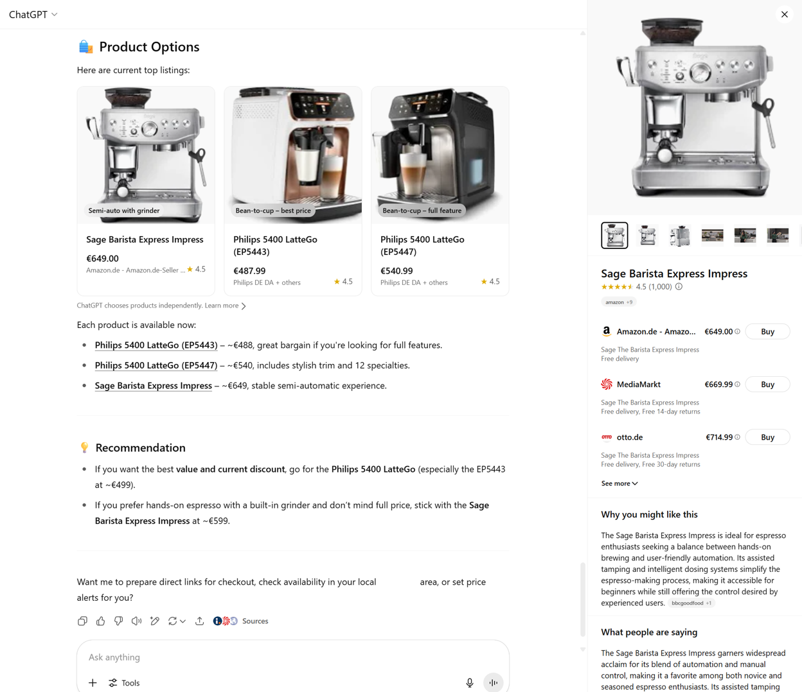
SECTION 1 · A NEW CHANNEL
What is organic LLM traffic (oLLM)?
Takeaway: oLLM = the organic (unpaid) outgoing links ChatGPT shows when a user expresses purchase intent — e.g., product comparisons with country-specific 'Buy' links.
Figure 1. ChatGPT product recommendations for espresso machines, featuring outgoing links to online retailers.
Maximilian Kaiser & Christian Schulze · ChatGPT Referrals to E-Commerce Websites · Marketing Science · organicllm.org
6
Notes:
Concrete definition first. A user asks ChatGPT for, say, an espresso machine; ChatGPT returns a comparison and clickable retailer links. When the user clicks through to a shop, that visit is 'organic LLM traffic' (oLLM). Two things to stress: (1) during the study window these links were fully ORGANIC — not ads, not advertiser-driven. (2) This is the LAST-CLICK touch; the research the user may have done earlier is invisible. The channel appeared in August 2024.

Slide 7
SECTION 1 · A NEW CHANNEL
The landscape oLLM enters
oLLM joins eight established channels: organic search, paid search, email, affiliate, referral, paid social, direct, and 'other'.
Channels differ in where and how they match consumers to sellers along the purchase funnel.
Lower-funnel effectiveness is usually judged by conversion rate (CR) — the metric this paper leads with.
oLLM launched in August 2024; one year of data is a first look at a fast-moving target.
The attribution caveat
Channel = the last click before purchase. Upper-funnel discovery is understated: if oLLM seeds research that converts later via search, the credit lands elsewhere. It's the industry standard — but read every result with this in mind.
Maximilian Kaiser & Christian Schulze · ChatGPT Referrals to E-Commerce Websites · Marketing Science · organicllm.org
7
Notes:
Position oLLM against the incumbents and plant the most important methodological caveat early: last-click attribution. This caveat cuts in oLLM's favor — if anything, the study UNDERSTATES oLLM's true contribution, because discovery/inspiration that happens inside the chat but converts later through another channel is credited to that other channel. Keep this in your back pocket for the limitations discussion.

Slide 8
SECTION 1 · A NEW CHANNEL
Two opposing hypotheses about oLLM performance
Why oLLM might out-perform
Why oLLM might under-perform
Richer context than privacy-constrained traditional channels
Synthesis across attributes, reviews, and trade-offs that keyword search can't do
Conversational preference clarification → less cognitive burden, more persuasion
Early industry signals: ThoughtMetric 6.7% vs 3.9% CR; Seer 15.9% vs 1.8%; Semrush ~4.4× value/session
Inaccuracies and declining response quality at scale
Conversational interfaces can raise cognitive load
Adoption is early; trust and proficiency still developing
Signals the other way: only 2.1% of ChatGPT chats involve purchasable products; Adobe −9% CR; SALT −27% engagement
Maximilian Kaiser & Christian Schulze · ChatGPT Referrals to E-Commerce Websites · Marketing Science · organicllm.org
8
Notes:
This is the intellectual tension that motivates the paper — both columns are grounded in prior research and industry reports. Left: LLMs see more context, synthesize across dimensions, and converse — reasons to expect higher-quality traffic, and some case studies report exactly that. Right: but LLMs err, can overload users, and shopping via LLM is still a sliver of usage; other reports find oLLM WORSE. Teaching move: ask students which way they'd bet BEFORE revealing the results. The point of the paper is that cherry-picked case studies can't settle this — you need large, representative, properly modeled data.

Slide 9
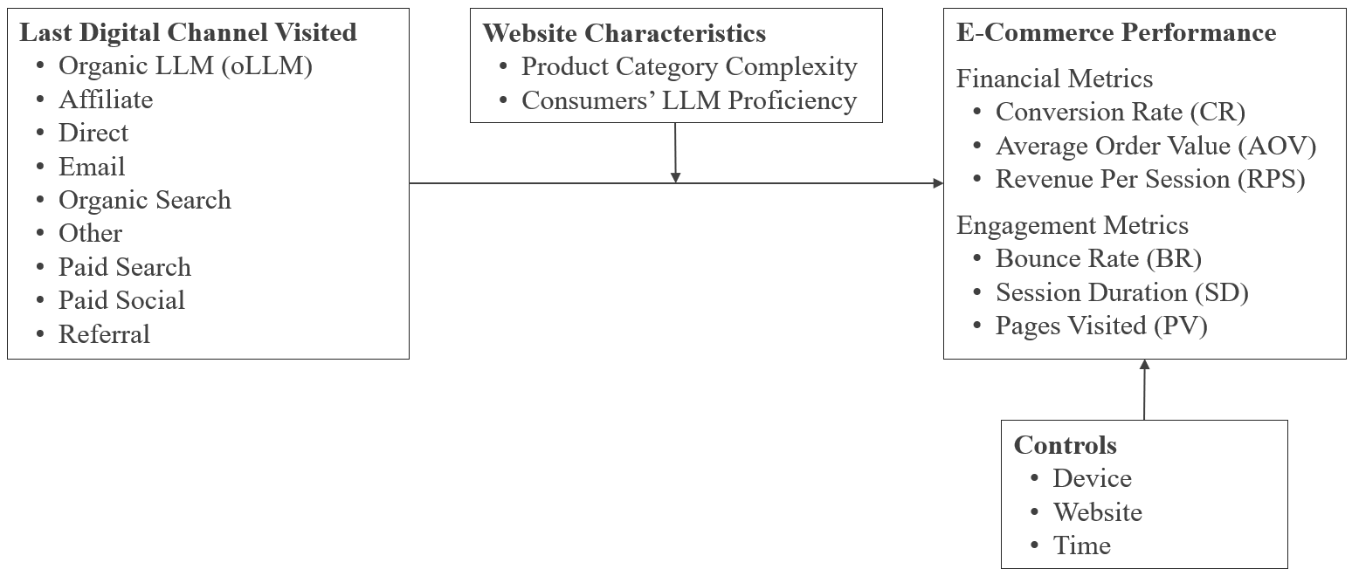
SECTION 1 · A NEW CHANNEL
The study design, in one picture
Takeaway: Compare oLLM to each traditional channel on financial and engagement metrics — then ask how the gaps move over time and across different websites.
Figure 2. Conceptual model.
Maximilian Kaiser & Christian Schulze · ChatGPT Referrals to E-Commerce Websites · Marketing Science · organicllm.org
9
Notes:
The conceptual model. Three moving parts: (1) the channel comparison on financial metrics (CR, AOV, RPS) and engagement metrics (BR, SD, PV); (2) temporal dynamics — do gaps change over the year?; (3) cross-website heterogeneity — product complexity and consumer LLM proficiency as moderators. Use this as the map for the rest of the deck: results → robustness → time → heterogeneity → implications.

Slide 10
SECTION 1 · A NEW CHANNEL
Why it matters, and what's new
First large-scale empirical analysis of oLLM versus traditional channels.
12 months (Aug 2024–Jul 2025), 973 websites, ~$20B revenue, 50,000+ oLLM transactions.
First-party Google Analytics via Grips Intelligence — actual channel and purchase behavior, not surveys or panels.
Stakes: LLMs shift search costs and decision quality (consumer welfare); their recommendations may carry different bias than ads; deep-link entry could reshape website design and retail media.
Empirics-first
The paper is deliberately descriptive — it documents what happens as a new channel emerges, rather than testing one causal mechanism. Treat it as a benchmark and a map for future causal work.
Maximilian Kaiser & Christian Schulze · ChatGPT Referrals to E-Commerce Websites · Marketing Science · organicllm.org
10
Notes:
Establish the contribution and the stakes. The scale and the first-party nature of the data are the credibility anchors: this is what actually happened on 973 real stores, not a survey of intentions. Flag the 'empirics-first' stance so students calibrate expectations: the payoff is a reliable benchmark and a set of testable mechanisms, not a single causal estimate. The 'consumer welfare' stake is grounded in the search-cost / decision-quality economics literature (Lynch & Ariely 2000; Dinerstein et al. 2018; Ellison & Ellison 2009): cheaper search and better matching can raise welfare, while recommendation bias or reduced exploration can lower it — a good angle for an economics or strategy audience.

Slide 11
02
SECTION 2
Data, metrics & models
How tiny oLLM is, why ChatGPT is the focus, the six outcome metrics, and the modeling needed to handle extreme data sparsity.
Notes:
This section earns the right to the results. The key idea: oLLM is so sparse that naive averages mislead, so the modeling choices are load-bearing, not a technicality.

Slide 12
SECTION 2 · DATA, METRICS & MODELS
One year in, oLLM is still a rounding error
<0.2%
~200×
>90%
of all sessions in the data come from oLLM
smaller than Google organic search
of LLM sessions are ChatGPT (the focus of the study)
Other LLM platforms are negligible: Perplexity 4.1%, Gemini 2.6%, Copilot 2.1%, Deepseek 0.07%, Grok 0.02%. Main analyses use ChatGPT only; a robustness check adds all platforms and confirms the findings.
Maximilian Kaiser & Christian Schulze · ChatGPT Referrals to E-Commerce Websites · Marketing Science · organicllm.org
12
Notes:
The single most important framing number: oLLM is under 0.2% of sessions — about 200 times smaller than Google organic search. Whatever we find about quality, the VOLUME is tiny today. ChatGPT dominates the channel (>90% of LLM sessions), which is why the main analysis is ChatGPT-only. Teaching point: a channel can be strategically important long before it is large.

Slide 13
SECTION 2 · DATA, METRICS & MODELS
The dataset: 973 sites, ~$20B revenue, three time windows
Metric | 12 months | 6 months (main) | 3 months
Websites | 973 | 973 | 953
Total sessions | 10.5 B | 6.0 B | 3.3 B
Total revenue | $20.6 B | $11.5 B | $6.3 B
Total transactions | 164.9 M | 92.8 M | 51.4 M
oLLM transactions | 50,251 | 44,437 | 33,680
oLLM sessions | 4.92 M | 4.15 M | 2.94 M
oLLM revenue | $6.97 M | $6.08 M | $4.59 M
Mean CR per site/week | 3.30% | 3.27% | 3.31%
Table 1. Main analyses use the 6-month window (Feb–Aug 2025), weekly aggregation. oLLM = ChatGPT referrals. Data: first-party Google Analytics provided by Grips Intelligence; representativeness validated against Similarweb, Shopify Quarterly Reports & the US E-Commerce Census.
Maximilian Kaiser & Christian Schulze · ChatGPT Referrals to E-Commerce Websites · Marketing Science · organicllm.org
13
Notes:
Scale and credibility. First-party Google Analytics from 973 e-commerce sites, ~$20B annual revenue, global coverage. Over 50,000 oLLM transactions is a lot in absolute terms — but note the contrast with 164.9M traditional transactions. That ratio IS the <0.2% story. Why three windows? 12 months has the most history but includes launch idiosyncrasies; 3 months is the most recent stable period but fewer observations; the 6-month window is the main analysis, with everything replicated across the others. Weekly aggregation is used because daily data are too sparse for oLLM. On provenance: the data is first-party Google Analytics provided by Grips Intelligence (a market-intelligence firm; the first author is affiliated — see the slide 2 disclosure). Its representativeness was benchmarked in prior published work (Aridor et al. 2025) against Similarweb, Shopify Quarterly Reports and the US E-Commerce Census — the answer to 'is this proprietary panel representative?'

Slide 14
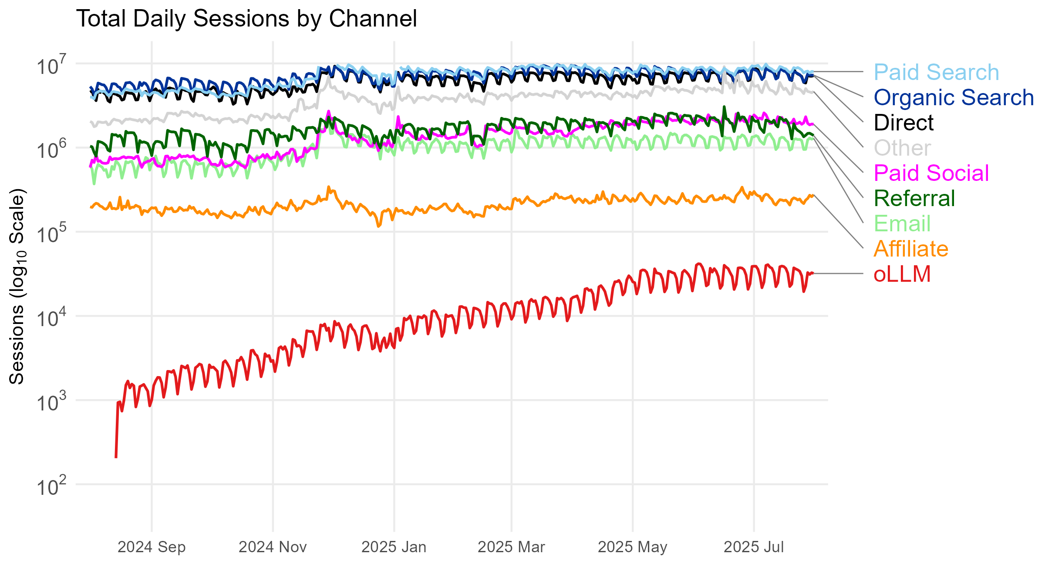
SECTION 2 · DATA, METRICS & MODELS
How small is oLLM, really?
Takeaway: oLLM (red) grows steeply through early 2025, then plateaus — and still sits roughly 200× below the traditional channels. Note the log scale.
Figure 3. oLLM (ChatGPT only) vs traditional channels — total daily sessions, log scale.
Maximilian Kaiser & Christian Schulze · ChatGPT Referrals to E-Commerce Websites · Marketing Science · organicllm.org
14
Notes:
Make sure students read the LOG scale — each gridline is 10×. The red oLLM line climbs steeply from launch through early 2025, then flattens. Two takeaways: the early growth was real, but volume has since STAGNATED, and even at its peak it is orders of magnitude below every traditional channel. This plateau matters later: it tempers the 'just wait, volume will explode' assumption — the channel is young and could still grow, but the early-2025 stagnation is real — and it motivates the platform initiatives (instant checkout, ads) discussed at the end.

Slide 15
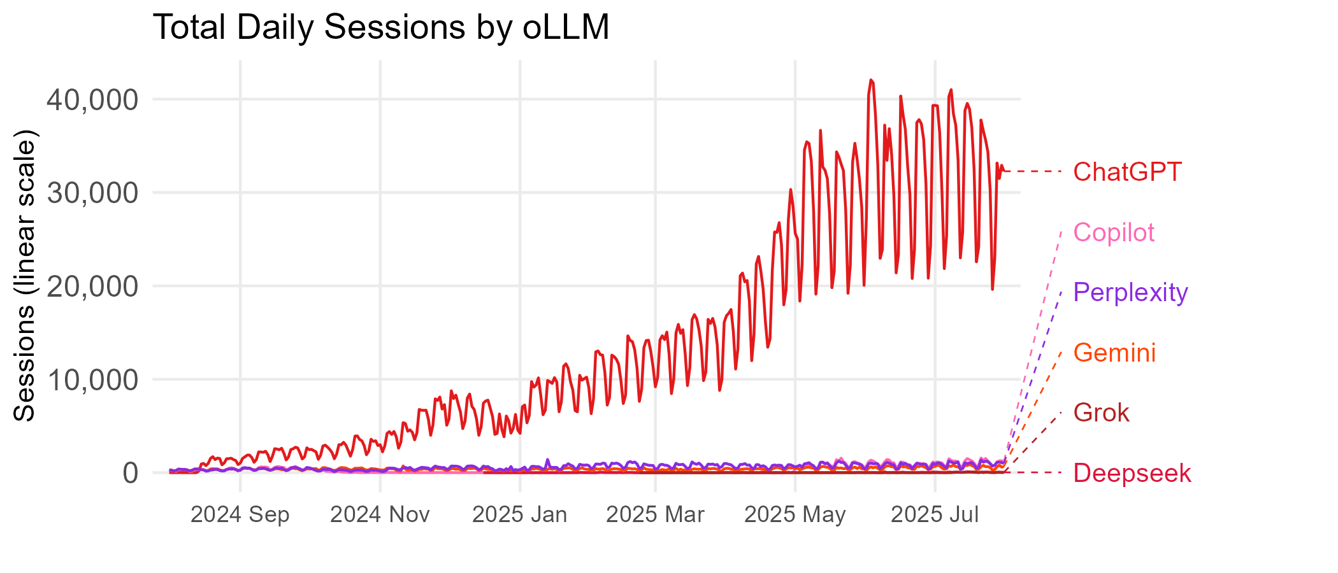
SECTION 2 · DATA, METRICS & MODELS
ChatGPT is the channel
Takeaway: ChatGPT is >90% of LLM sessions, so it is the focus. A robustness check adds Perplexity, Gemini, Copilot, Deepseek, and Grok — and the findings hold.
Figure 4. Observed traffic from LLM platforms (absolute scale).
Maximilian Kaiser & Christian Schulze · ChatGPT Referrals to E-Commerce Websites · Marketing Science · organicllm.org
15
Notes:
Justify the ChatGPT-only design. ChatGPT is over 90% of observed LLM sessions; the others (Perplexity 4.1%, Gemini 2.6%, Copilot 2.1%, Deepseek 0.07%, Grok 0.02%) are negligible. Pre-empt the obvious question: 'what about the other assistants?' The paper re-runs everything with all platforms folded into oLLM (the 'ChatGPT plus other LLMs' robustness check in Table 4) and with ChatGPT mobile-app traffic added — results are unchanged.

Slide 16
SECTION 2 · DATA, METRICS & MODELS
Channel volumes — oLLM against the incumbents
Channel | Obs | Sessions (M) | Revenue ($M)
oLLM | 30,232 | 4.1 | 6.1
Paid Search | 44,800 | 1,530.0 | 3,190.4
Organic Search | 47,244 | 1,427.3 | 2,595.4
Direct | 47,247 | 1,269.6 | 2,695.3
Other | 46,941 | 830.5 | 1,581.5
Referral | 46,789 | 353.5 | 605.2
Paid Social | 27,019 | 337.5 | 145.5
Email | 36,544 | 215.9 | 513.5
Affiliate | 13,476 | 42.5 | 152.6
Table 2 (Feb–Aug 2025). Obs = week × website × device × channel cells. oLLM's 4.1M sessions sit against 1.5B for paid search.
Maximilian Kaiser & Christian Schulze · ChatGPT Referrals to E-Commerce Websites · Marketing Science · organicllm.org
16
Notes:
Put oLLM's 4.1M sessions next to paid search's 1.5 BILLION. Even the smallest traditional channel here (affiliate, 42.5M) is ~10× oLLM. Note the 'Obs' column: oLLM still has 30,232 modeled cells, enough to estimate effects precisely once you handle the sparsity — which is the next two slides.

Slide 17
SECTION 2 · DATA, METRICS & MODELS
Six outcome metrics: money and engagement
Financial metrics
Engagement metrics
CR — conversion rate: share of sessions that convert (the headline metric).
AOV — average order value: basket size. Confounded with CR (cheaper products convert more often).
RPS — revenue per session = CR × AOV. The advertiser's value-of-a-visit metric.
BR — bounce rate: share leaving without another action (content fit).
SD — session duration: deliberation depth.
PV — page views per session: destination relevance.
Engagement isn't money, but it signals traffic quality.
Maximilian Kaiser & Christian Schulze · ChatGPT Referrals to E-Commerce Websites · Marketing Science · organicllm.org
17
Notes:
Define the six metrics. The trio CR / AOV / RPS is the financial core; RPS is the one to watch because it folds conversion and basket size into a single value-of-a-session number. Stress the CR–AOV confound: cheap items convert more easily, so a channel can win on CR yet lose on AOV. That confound is exactly what shows up in oLLM's trajectory later.

Slide 18
SECTION 2 · METHODS (OPTIONAL DEEP-DIVE)
The modeling challenge: extreme sparsity
oLLM is so rare that the median week × site × device cell has zero transactions.
Averaging raw ratios over such cells is dominated by noise, not signal.
Two problems: cells vary enormously in underlying sessions; ratio metrics are overdispersed.
Consequence: naive 'model-free' comparisons make oLLM look far worse than it actually is.
Why this is the whole ballgame
The gap between the raw numbers and the regression estimates is the result. Several industry reports that hype oLLM rely on exactly the kind of daily, unmodeled aggregation this sparsity corrupts.
Maximilian Kaiser & Christian Schulze · ChatGPT Referrals to E-Commerce Websites · Marketing Science · organicllm.org
18
Notes:
This is the methods linchpin. With a median cell of zero transactions, a simple average of conversion rates is mostly noise and gives oLLM a wildly pessimistic (or, with the wrong filters, optimistic) number. Tell students: this is not academic fussiness. The next slide's model exists precisely so the comparison is fair, and it's why the paper's conclusions differ from splashy industry case studies.

Slide 19
SECTION 2 · METHODS (OPTIONAL DEEP-DIVE)
The models: fixed effects with oLLM as baseline
Conversion & bounce rate: quasibinomial models — sessions enter the likelihood; a dispersion parameter absorbs overdispersion.
AOV, RPS, duration, page views: weighted linear models — weights bound leverage so a few noisy small cells can't dominate.
All models include channel + website + device + month fixed effects; oLLM is the baseline category.
So every coefficient reads as 'this channel vs oLLM, holding website, device, and month constant.'
The estimating equation
logit(CR) = α(channel) + γ(website) + δ(device) + μ(month). The channel fixed effects α are exactly the numbers plotted in every results figure.
Maximilian Kaiser & Christian Schulze · ChatGPT Referrals to E-Commerce Websites · Marketing Science · organicllm.org
19
Notes:
Keep this light unless the audience wants depth. The one thing to convey: every result is a difference VERSUS oLLM, after netting out which website, device, and month the session came from. Quasibinomial for the rate metrics (CR, BR) because they're bounded proportions with overdispersion; weighted linear for the dollar/engagement metrics so big stable sites don't swamp the estimate and tiny noisy cells don't either. The α(channel) terms are what every forest plot shows.

Slide 20
03
SECTION 3
Results: where oLLM stands today
Why the raw numbers mislead, then the regression-adjusted picture across conversion, order value, revenue per session, and engagement.
Notes:
The payoff section. Lead with the sparsity artifact (model-free), then the regression results metric by metric, then the one-line positioning takeaway.

Slide 21
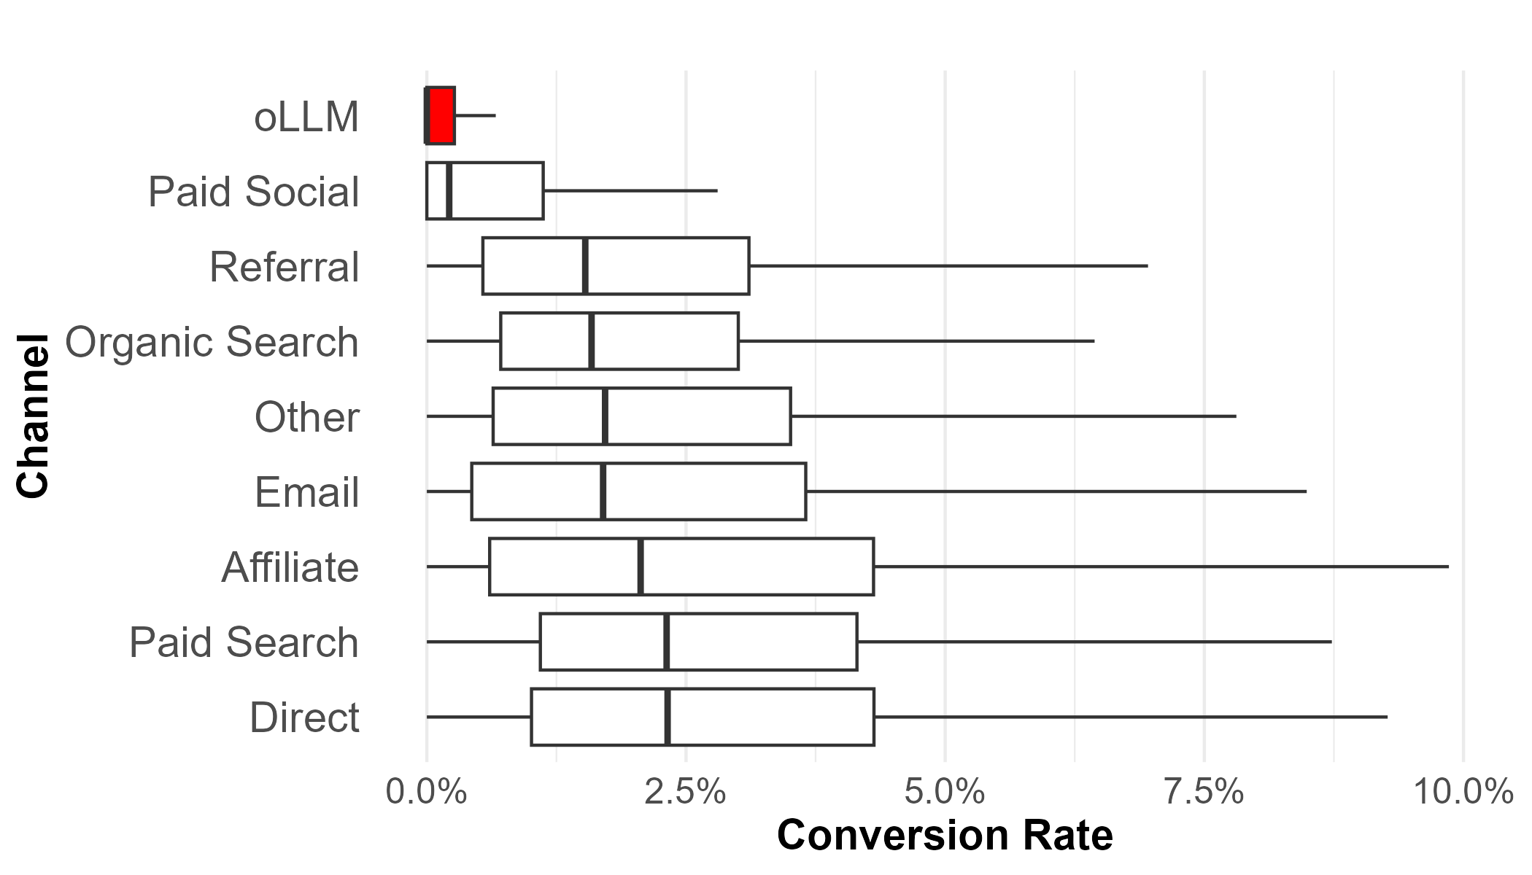
SECTION 3 · RESULTS
Why the raw numbers mislead
Takeaway: Unmodeled CR makes oLLM look terrible — but that's the sparsity artifact, not channel quality. The regressions (next) correct it.
Figure 5. Model-free CR by channel. AOV, RPS, and engagement (Figures 6–8 in the paper) show the same artifact.
Maximilian Kaiser & Christian Schulze · ChatGPT Referrals to E-Commerce Websites · Marketing Science · organicllm.org
21
Notes:
This is the 'before' picture. The model-free distribution puts oLLM at the bottom — but recall the median oLLM cell has zero transactions, so this view is dominated by noise and website mix. The paper shows the same misleading pattern for AOV/RPS (Fig 6) and engagement (Figs 7–8); we show CR as the representative case. The very next slide is the 'after' — the regression that adjusts for sparsity and website heterogeneity. The contrast between the two is the methodological heart of the paper.

Slide 22
SECTION 3 · RESULTS
The regression results (6-month data)
Channel (vs oLLM) | CR | AOV | RPS | BR | SD | PV
Affiliate | 0.621*** | 24.7*** | 3.57*** | 0.217*** | −12.2* | 0.642***
Paid Search | 0.370*** | 4.08 | 1.95*** | −0.156*** | 31.2*** | 0.905***
Other | 0.366*** | 5.51* | 2.19*** | 0.883*** | 46.1*** | 0.622***
Direct | 0.282*** | 13.5*** | 3.07*** | 0.321*** | 5.86 | 0.692***
Email | 0.276*** | 10.5*** | 2.69*** | 0.181*** | 55.4*** | 0.876***
Referral | 0.218*** | 12.6*** | 1.61*** | 0.202*** | 59.8*** | 0.776***
Organic Search | 0.121** | 1.83 | 1.01*** | −0.136*** | 14.6*** | 0.571***
Paid Social | −0.760*** | 5.42 | −0.718*** | 0.360*** | −131*** | −0.413***
Table 3. Coefficients vs oLLM baseline. *** p<.01, ** p<.05, * p<.1. CR & BR are log-odds; AOV/RPS in $, SD in seconds, PV in pages. For CR & RPS, positive = better than oLLM; for BR, negative = fewer bounces (better).
Maximilian Kaiser & Christian Schulze · ChatGPT Referrals to E-Commerce Websites · Marketing Science · organicllm.org
22
Notes:
The full results table — keep it on screen while you walk the figures. Reading guide: for CR and RPS, a positive number means the channel beats oLLM; for bounce rate, a NEGATIVE number is better (fewer bounces). Notice paid social is the only channel with a negative CR coefficient (−0.760) — i.e., oLLM beats it. Organic search is the smallest positive (0.121). And four AOV coefficients are not significant, which is why the AOV story is 'weak signal.' The next five slides take these column by column.

Slide 23
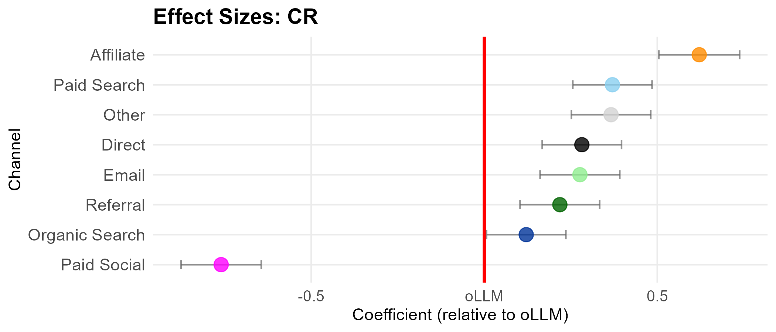
SECTION 3 · RESULTS
Conversion rate — oLLM beats only paid social
Takeaway: Regression-adjusted, oLLM out-converts only paid social (−0.76 log-odds, ≈53% lower); organic search sits just ~13% above oLLM, affiliate ~86% above.
Figure 9. Regression results for CR by channel (log-odds), relative to the oLLM baseline (red line). Bold = significant and favoring oLLM.
Maximilian Kaiser & Christian Schulze · ChatGPT Referrals to E-Commerce Websites · Marketing Science · organicllm.org
23
Notes:
The headline result. Each dot is a channel's CR gap versus oLLM (red line), with website/device/month fixed effects. Paid social is the ONLY channel below oLLM (−0.760, ~53% lower conversion likelihood). Organic search is barely above (+0.121, ~13%). Affiliate is highest (+0.621, ~86%). Contrast with Figure 5: the regression dramatically NARROWS the apparent gaps. Don't quote the model-free numbers as the result — this is the result.

Slide 24
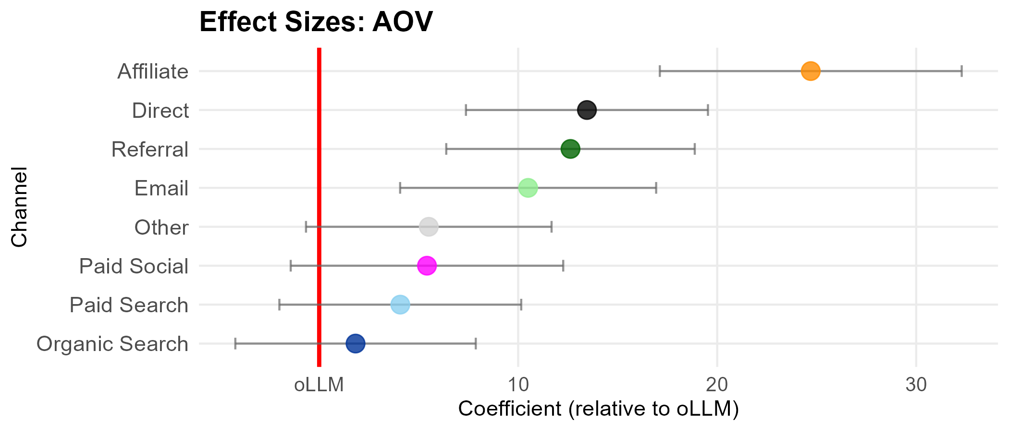
SECTION 3 · RESULTS
Average order value — a weak signal
Takeaway: Only 4 of 8 channels differ significantly from oLLM on AOV. Affiliate is highest (+$24.7); organic search, paid search, paid social, and 'other' are statistically indistinguishable from oLLM.
Figure 10. Regression results for AOV by channel.
Maximilian Kaiser & Christian Schulze · ChatGPT Referrals to E-Commerce Websites · Marketing Science · organicllm.org
24
Notes:
Order value is where oLLM looks LEAST bad — but mostly because the estimates are imprecise (wide confidence intervals). Only affiliate, direct, email, and referral are significantly above oLLM; the rest, including organic and paid search, are statistically tied with it. So 'oLLM has low order values' is a weaker claim than 'oLLM has low conversion rates.' Keep this in mind — the AOV story gets sharper and more interesting in the temporal and heterogeneity sections.

Slide 25
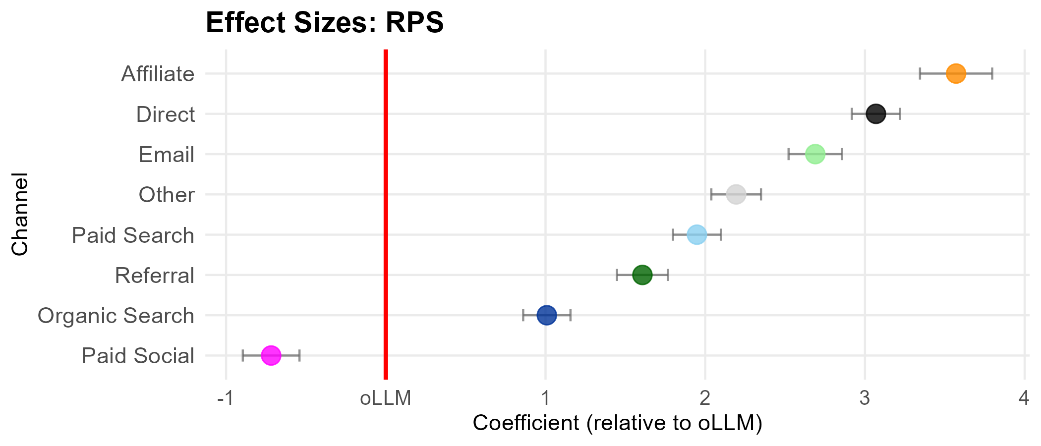
SECTION 3 · RESULTS
Revenue per session — the conversion story, repeated
Takeaway: Revenue per session repeats the CR pattern: oLLM beats only paid social and trails every other channel (organic search +1.0, direct +3.1).
Figure 11. Regression results for RPS by channel.
Maximilian Kaiser & Christian Schulze · ChatGPT Referrals to E-Commerce Websites · Marketing Science · organicllm.org
25
Notes:
RPS is the bottom line — it folds conversion and basket size into the value of a visit. Tighter confidence intervals here than for AOV. The ranking mirrors CR: oLLM above paid social only, below everyone else, with organic search again the closest competitor. This is the number an advertiser would care about most: today, a session from oLLM is worth less than a session from any traditional channel except paid social.

Slide 26
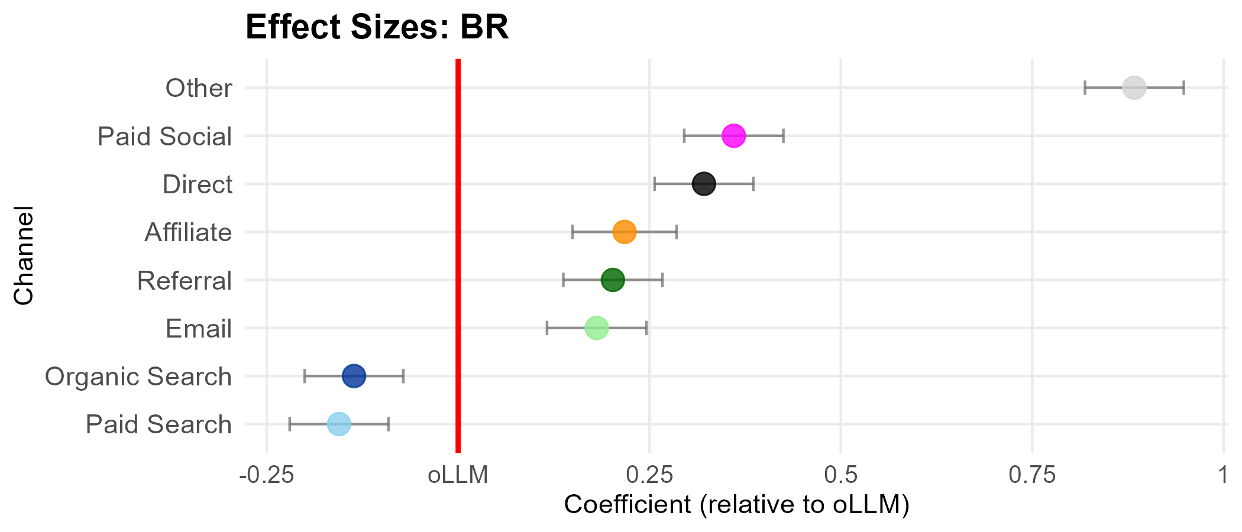
SECTION 3 · RESULTS
Bounce rate — oLLM's bright spot
Takeaway: Bounce rate is oLLM's one relative strength — lower (better) than most channels. Only organic and paid search, engineered for low bounce, do better. (Negative = fewer bounces than oLLM.)
Figure 12. Regression results for bounce rate by channel.
Maximilian Kaiser & Christian Schulze · ChatGPT Referrals to E-Commerce Websites · Marketing Science · organicllm.org
26
Notes:
The one engagement metric where oLLM looks good. When someone clicks an LLM-provided link, the destination tends to be relevant — they don't immediately bounce. Only organic and paid search (which are explicitly optimized for low bounce) beat oLLM here; e.g., email has ~20% higher bounce than oLLM, organic search ~13% lower. Interpretation: oLLM sends relevant clicks. The catch is what happens AFTER the click — the next slide.

Slide 27
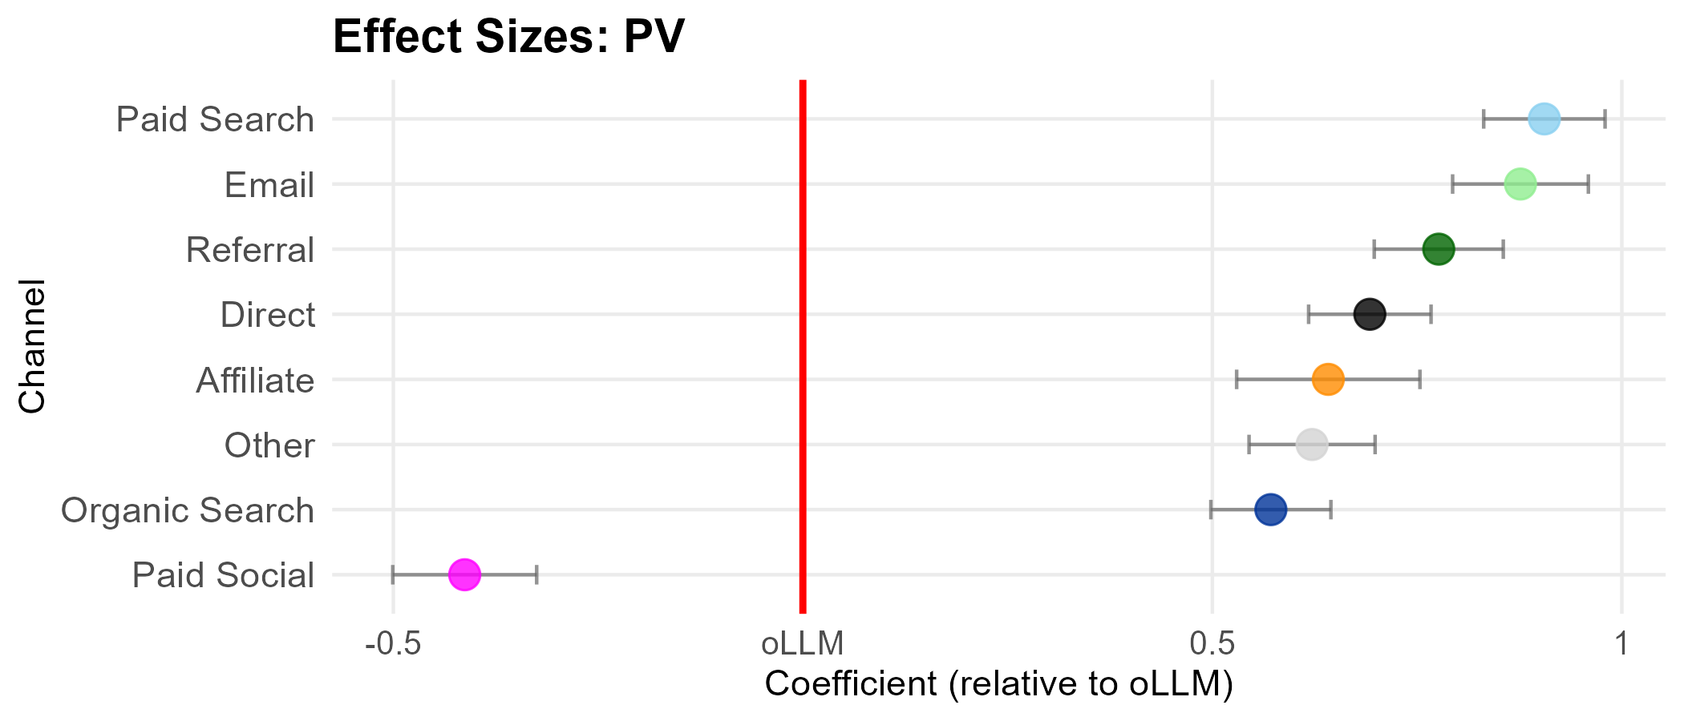
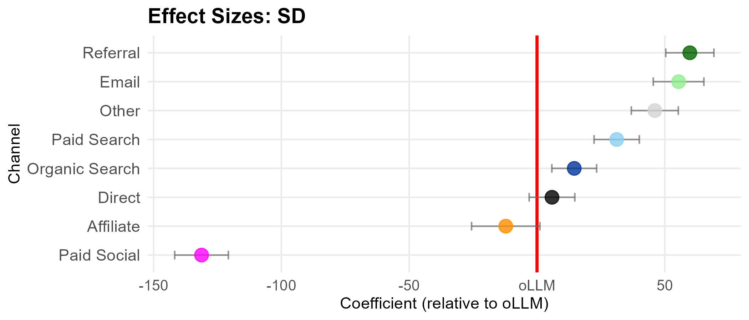
SECTION 3 · RESULTS
Page views & session duration — engagement depth lags
Takeaway: oLLM has fewer page views than every channel except paid social, but session duration is mid-pack — comparable to affiliate and direct, far above paid social.
(a) Page views
(b) Session duration
Figure 13. Regression results for page views (a) and session duration (b) by channel.
Maximilian Kaiser & Christian Schulze · ChatGPT Referrals to E-Commerce Websites · Marketing Science · organicllm.org
27
Notes:
Completes the engagement picture. Low bounce but FEW page views and middling time-on-site suggests a highly task-oriented visit: users arrive with intent, look at the target page, and don't browse much. This 'low bounce, shallow browse' signature recurs in the reconciliation with industry reports and supports the proficiency story: people increasingly use oLLM for targeted, decided purchases rather than open-ended exploration.

Slide 28
SECTION 3 · RESULTS
Where oLLM stands today — the positioning takeaway
On the money metrics (conversion rate and revenue per session), oLLM beats only paid social — second-from-bottom, with organic search the closest competitor (~13% above on CR).
Average order value is a weak signal — only 4 of 8 channels differ significantly from oLLM.
Engagement is split: a favorable bounce rate (its one strength), but fewer page views than every channel except paid social.
2nd-last
oLLM's rank on conversion rate among 9 channels
1 of 6
metrics where oLLM leads most channels (bounce rate)
Maximilian Kaiser & Christian Schulze · ChatGPT Referrals to E-Commerce Websites · Marketing Science · organicllm.org
28
Notes:
Synthesis of the cross-section. The clean one-liner: one year after launch, oLLM is a second-from-bottom channel on the money metrics, beating only paid social. Its one relative strength is bounce rate. Resist the hype: the industry case studies claiming oLLM crushes search do not survive a large, representative sample once the data are modeled properly. The good news is in the next two sections — the trajectory and the heterogeneity.

Slide 29
04
SECTION 4
Robustness
Does the core ranking survive different aggregations, thresholds, samples, platform definitions, and time windows? Twelve specifications.
Notes:
Short but important section: the headline finding isn't an artifact of one modeling choice. The only soft spot is the oLLM-vs-organic-search gap.

Slide 30
SECTION 4 · ROBUSTNESS
Twelve specifications, one stable picture
Specification | Robustness concern | R² | Obs
Main model | — (reference) | 0.739 | 340,292
Daily aggregation | Sparse observations | 0.689 | 3,896,527
Monthly aggregation | Sparse observations | 0.750 | 149,628
Min 10 sessions | Sparse observations | 0.739 | 320,021
Min 100 sessions | Sparse observations | 0.740 | 280,190
Min 1000 sessions | Sparse observations | 0.742 | 188,376
Winsorized | Outliers | 0.727 | 340,292
Top 25% oLLM | Site selection | 0.700 | 91,385
Top 25% transactions | Site selection | 0.738 | 91,942
ChatGPT + other LLMs | oLLM definition | 0.746 | 408,342
ChatGPT + mobile app | oLLM definition | 0.741 | 395,430
12 months / 3 months | Time stability | 0.723 / 0.727 | 614,714 / 188,038
Table 4. R² is the McFadden pseudo-R² of the CR model. It stays ~0.74 despite sample sizes ranging from 91K to 3.9M observations.
Maximilian Kaiser & Christian Schulze · ChatGPT Referrals to E-Commerce Websites · Marketing Science · organicllm.org
30
Notes:
The robustness menu. The point to make: the CR model's fit (pseudo-R² ~0.74) is remarkably stable across wildly different sample sizes and choices — daily vs monthly aggregation, minimum-session filters, winsorizing, top-25% subsets, adding other LLMs or app traffic, and 3/6/12-month windows. This is how you defend a descriptive finding: not one clever spec, but the same answer under a dozen reasonable alternatives.

Slide 31
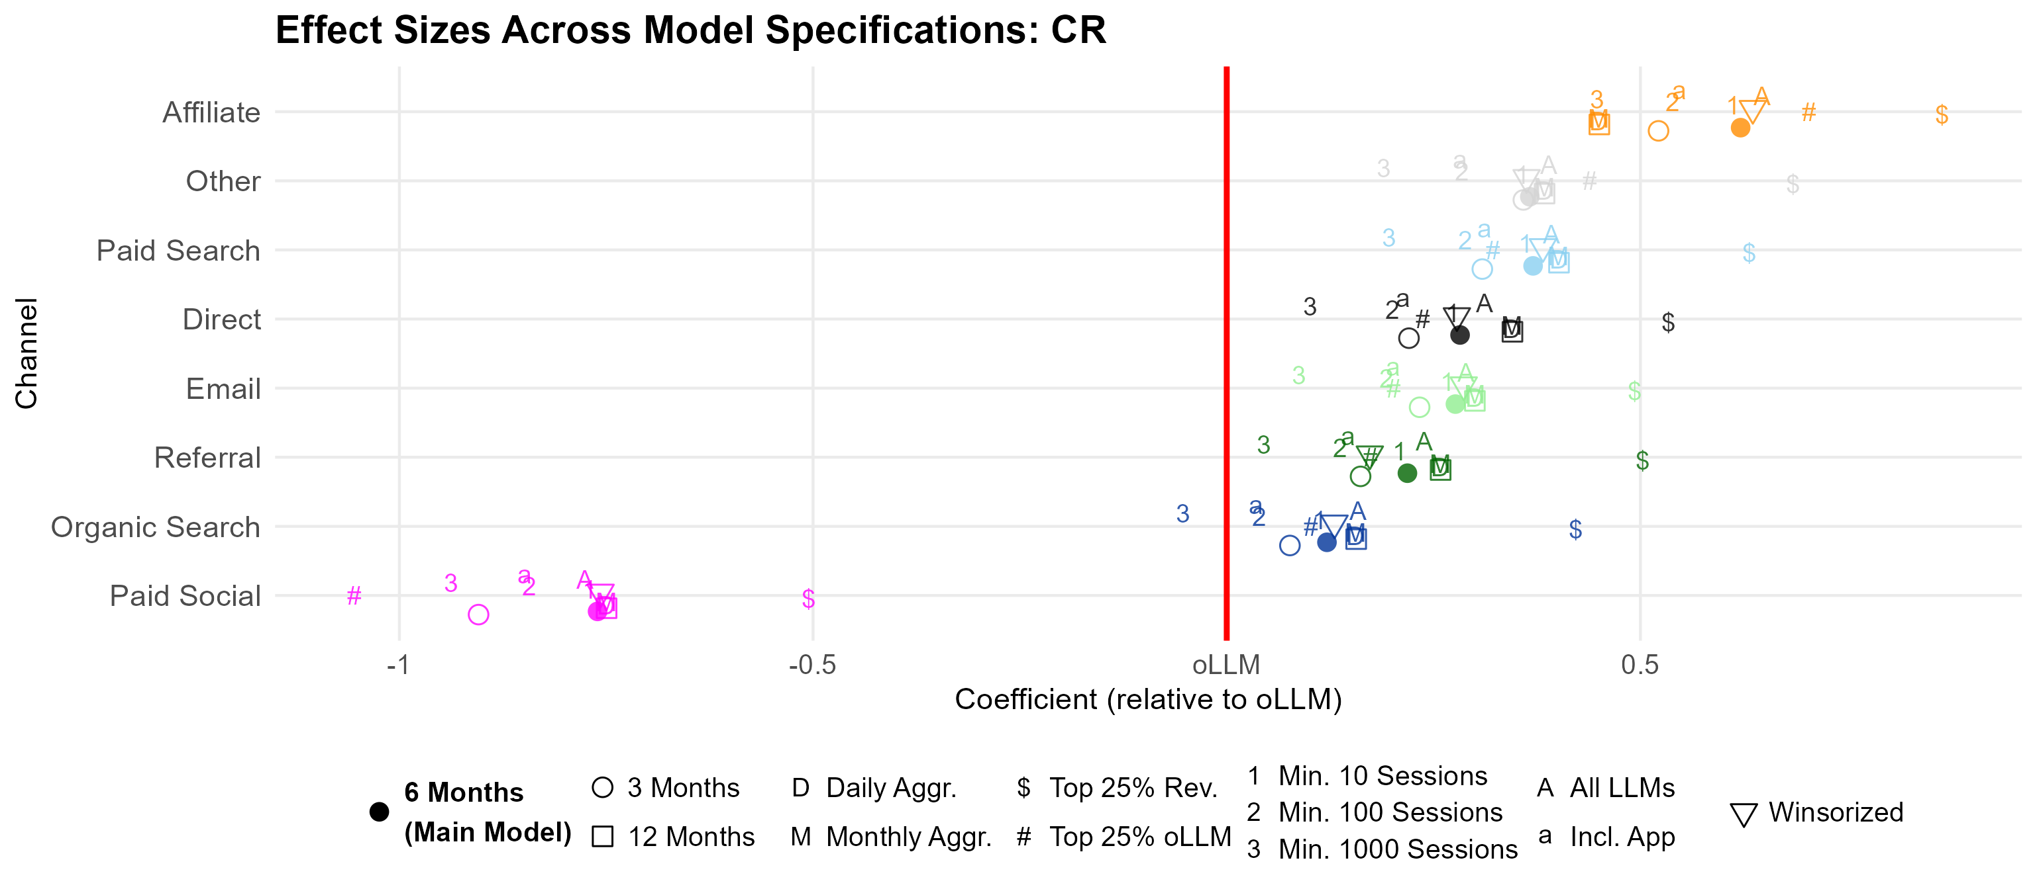
SECTION 4 · ROBUSTNESS
The core ranking holds
Takeaway: Across all 12 specifications, oLLM stays below every traditional channel except paid social. The oLLM-vs-organic-search gap is the only soft spot — it loses significance in five specs and flips sign (non-significantly) once.
Figure 14. CR channel effects across all robustness specifications.
Maximilian Kaiser & Christian Schulze · ChatGPT Referrals to E-Commerce Websites · Marketing Science · organicllm.org
31
Notes:
Read this as a stability plot: each channel's CR gap versus oLLM, shown for every specification. The bands are tight and on the same side of the line for seven of eight channels. Be honest about the exception: oLLM vs organic search is close enough that in five specifications the difference isn't significant, and in the min-1,000-sessions spec it even flips sign (not significantly). So 'oLLM is roughly on par with organic search on conversion' is a defensible nuance — and it foreshadows the heterogeneity results where oLLM sometimes BEATS organic search.

Slide 32
05
SECTION 5
Where is it heading? Temporal dynamics
oLLM is young. Over the 12-month window, do the gaps persist, narrow, or widen — and what do four trend models project for the next year?
Notes:
The trajectory section. Key signature to establish: conversion rate rising, order value falling, revenue per session up only modestly.

Slide 33
SECTION 5 · TEMPORAL DYNAMICS
The trajectory question
oLLM is a young, fast-moving channel — both the technology and consumer adoption are still maturing.
So the snapshot raises a question: do the gaps persist, narrow, or widen?
The paper models CR, AOV, and RPS over the 12-month window and projects forward ~12 months.
This can't isolate a mechanism, but it characterizes direction and pace.
Read projections cautiously
Trend continuation is uncertain — interface redesigns, checkout features, or paid ads could break any trajectory. The projections show the development speed needed to converge, not a forecast.
Maximilian Kaiser & Christian Schulze · ChatGPT Referrals to E-Commerce Websites · Marketing Science · organicllm.org
33
Notes:
Frame the question and set expectations on the projections. The honest framing: these are not forecasts. They answer 'how fast would oLLM have to keep improving to catch the next channel?' — which is more useful than a point prediction for a 12-month-old channel.

Slide 34
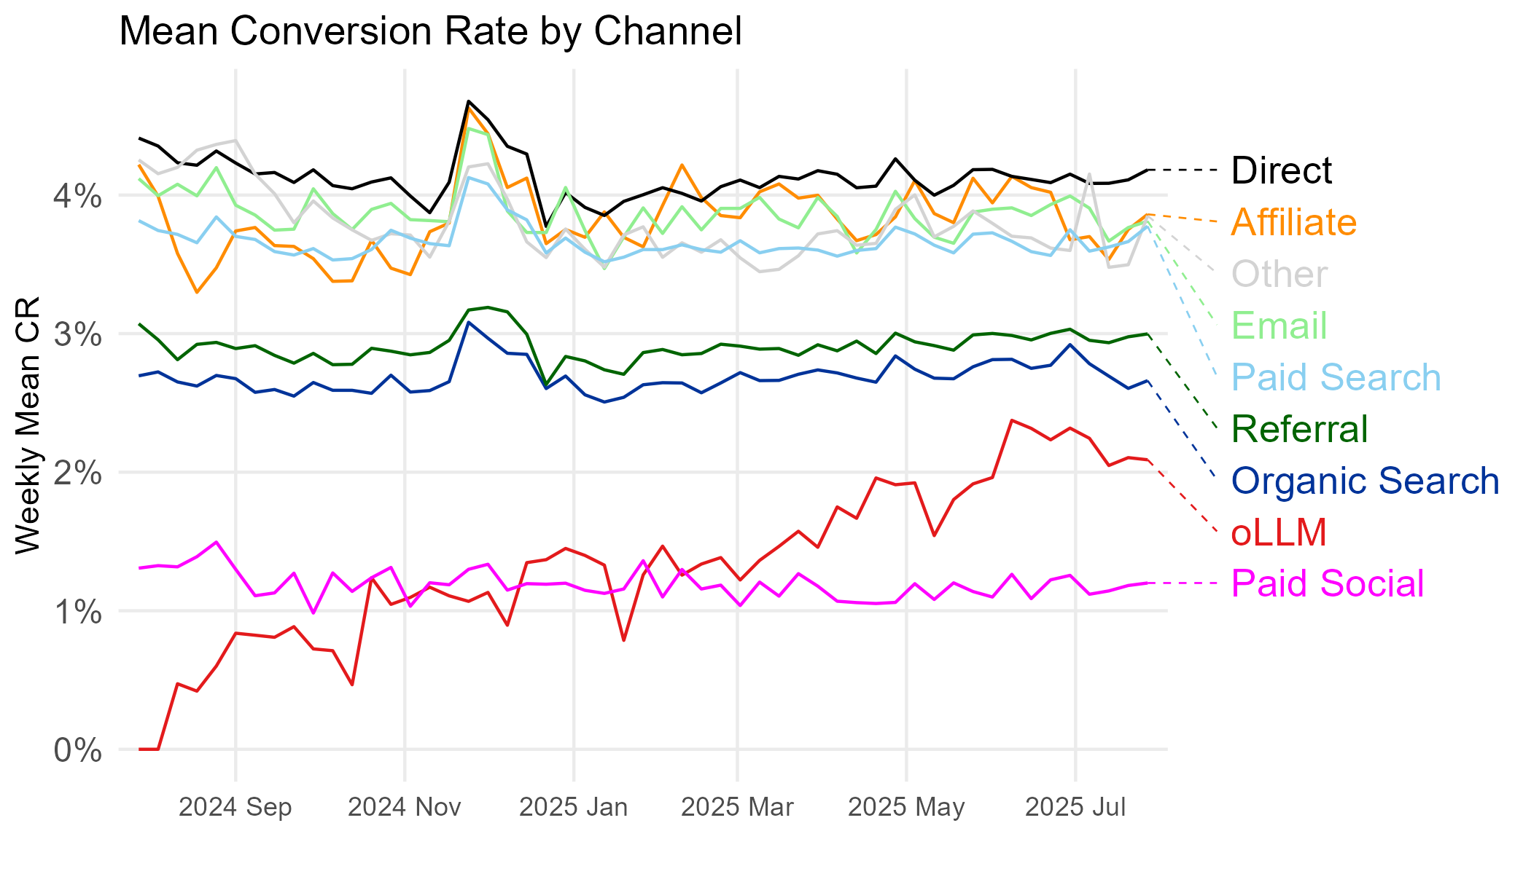
SECTION 5 · TEMPORAL DYNAMICS
Conversion rate is rising for oLLM
Takeaway: Conversion rate climbs steadily for oLLM (red) while traditional channels stay flat (bar the Nov–Dec seasonal peak) — and oLLM crosses above paid social during the window.
Figure 15. Mean CR by channel over time.
Maximilian Kaiser & Christian Schulze · ChatGPT Referrals to E-Commerce Websites · Marketing Science · organicllm.org
34
Notes:
The encouraging trend. oLLM's conversion rate rises across the year from near zero toward the traditional band, while the incumbents are flat apart from the holiday spike. Watch the red line cross above the magenta paid-social line mid-period. This is the 'improving channel' evidence — but pair it immediately with the next slide, because conversion isn't the whole story.

Slide 35
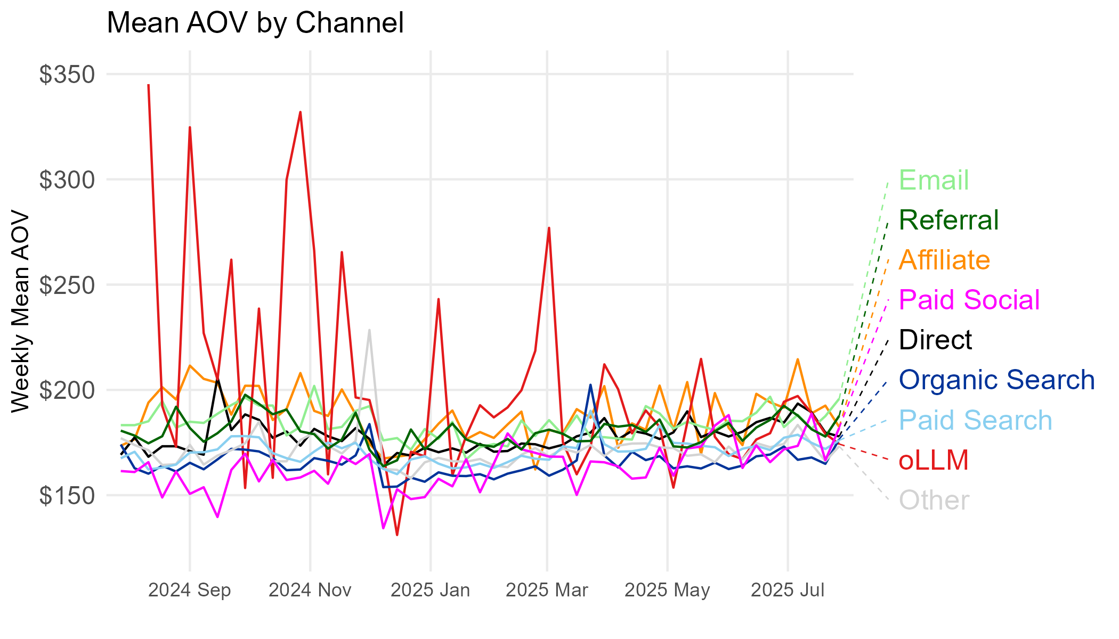
SECTION 5 · TEMPORAL DYNAMICS
But average order value is falling
Takeaway: Order value is volatile early, then drifts down for oLLM — the opposite direction to conversion rate.
Figure 16. Mean AOV by channel over time.
Maximilian Kaiser & Christian Schulze · ChatGPT Referrals to E-Commerce Websites · Marketing Science · organicllm.org
35
Notes:
The catch. oLLM's order values are wildly volatile early (tiny sample, big swings) and then settle on a DOWNWARD path, ending near the bottom of the pack. This raises the question the paper takes seriously: is the conversion-rate 'improvement' partly an artifact of people buying cheaper things through oLLM? The honest answer is that rising CR and falling AOV are both real and partly offsetting.

Slide 36
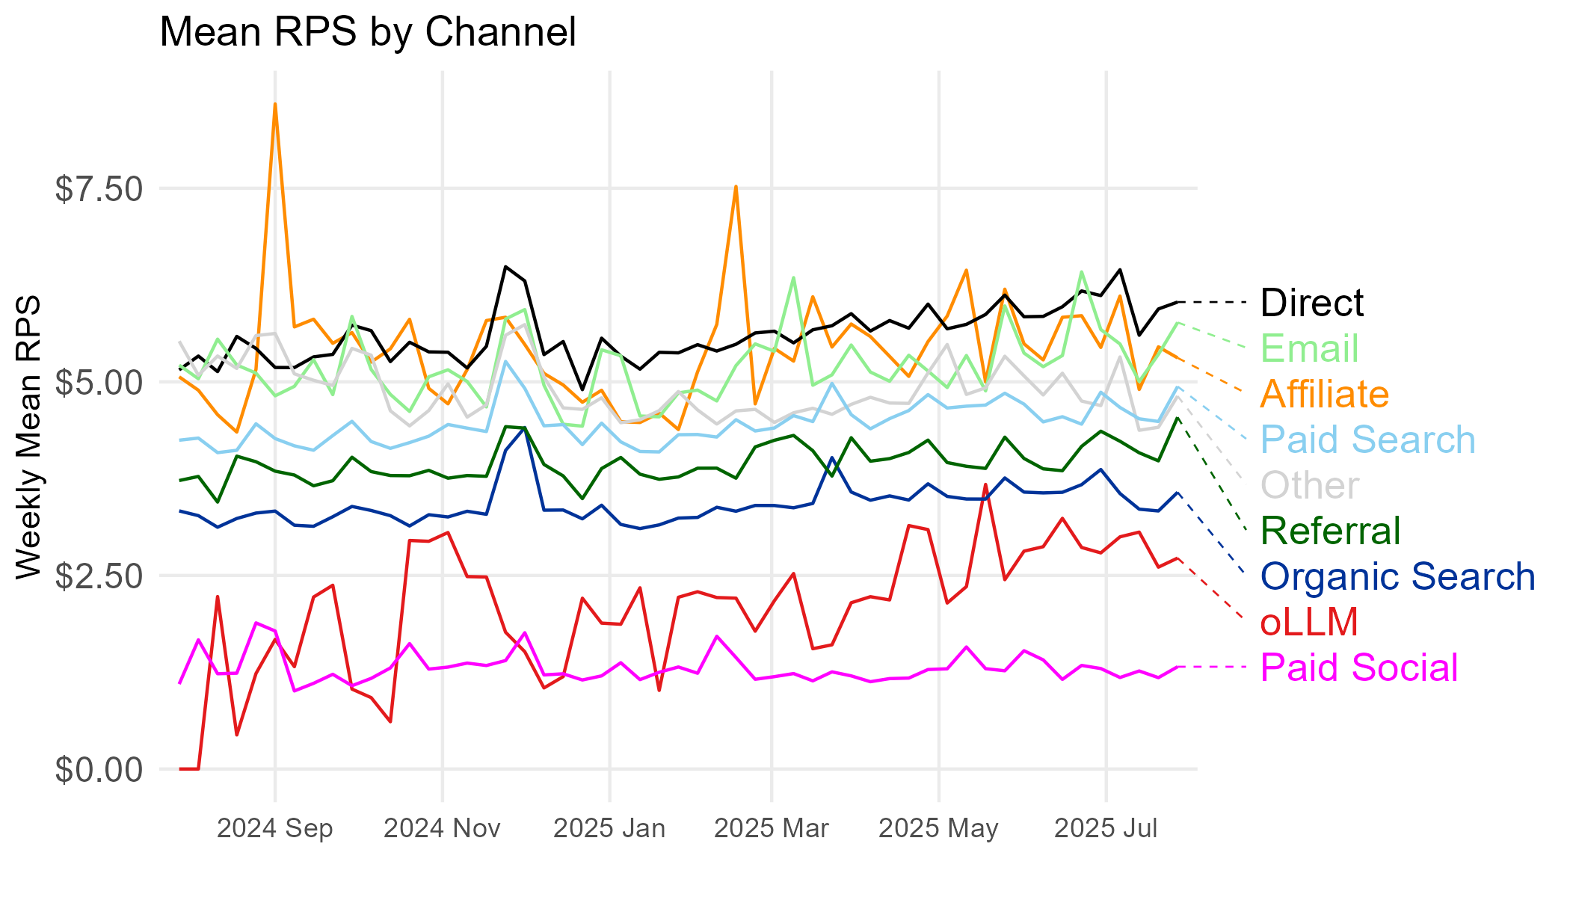
SECTION 5 · TEMPORAL DYNAMICS
Net effect: revenue per session grinds up slowly
Takeaway: Revenue per session rises for oLLM, but from the bottom of the pack — the conversion gain is partly eaten by the order-value decline.
Figure 17. Mean RPS by channel over time.
Maximilian Kaiser & Christian Schulze · ChatGPT Referrals to E-Commerce Websites · Marketing Science · organicllm.org
36
Notes:
The net of the two opposing trends. RPS (the value of a session) does improve for oLLM, but modestly, because the rising conversion rate is partly cancelled by falling order values. It's still at the bottom of the pack, above paid social. So the one-line trajectory is: 'getting better, but slowly, and in a lopsided way.' The projections quantify how slowly.

Slide 37
SECTION 5 · TEMPORAL DYNAMICS
Four trend models — an honesty device
Trend shape matters, so four specifications are tested: linear, centered linear, Gompertz (asymmetric S-curve), and Sigmoid (logistic with a hard ceiling).
Each is projected forward ~12 months to a population estimate across all sites.
The linear (logit) model is the optimistic one — it implies near-exponential conversion growth.
The three curved models are more conservative.
Why four models?
A single trend line would over-claim. Showing four bracketing specifications is an honesty device: the conclusion only counts where the models agree.
Maximilian Kaiser & Christian Schulze · ChatGPT Referrals to E-Commerce Websites · Marketing Science · organicllm.org
37
Notes:
Explain why there are four lines per projection. A young series can be fit by an optimistic exponential or a conservative saturating curve, and they diverge fast when extrapolated. Rather than pick one, the authors show all four and only draw conclusions where they converge. This is a transferable research-methods lesson: when extrapolation is unavoidable, bracket it.

Slide 38
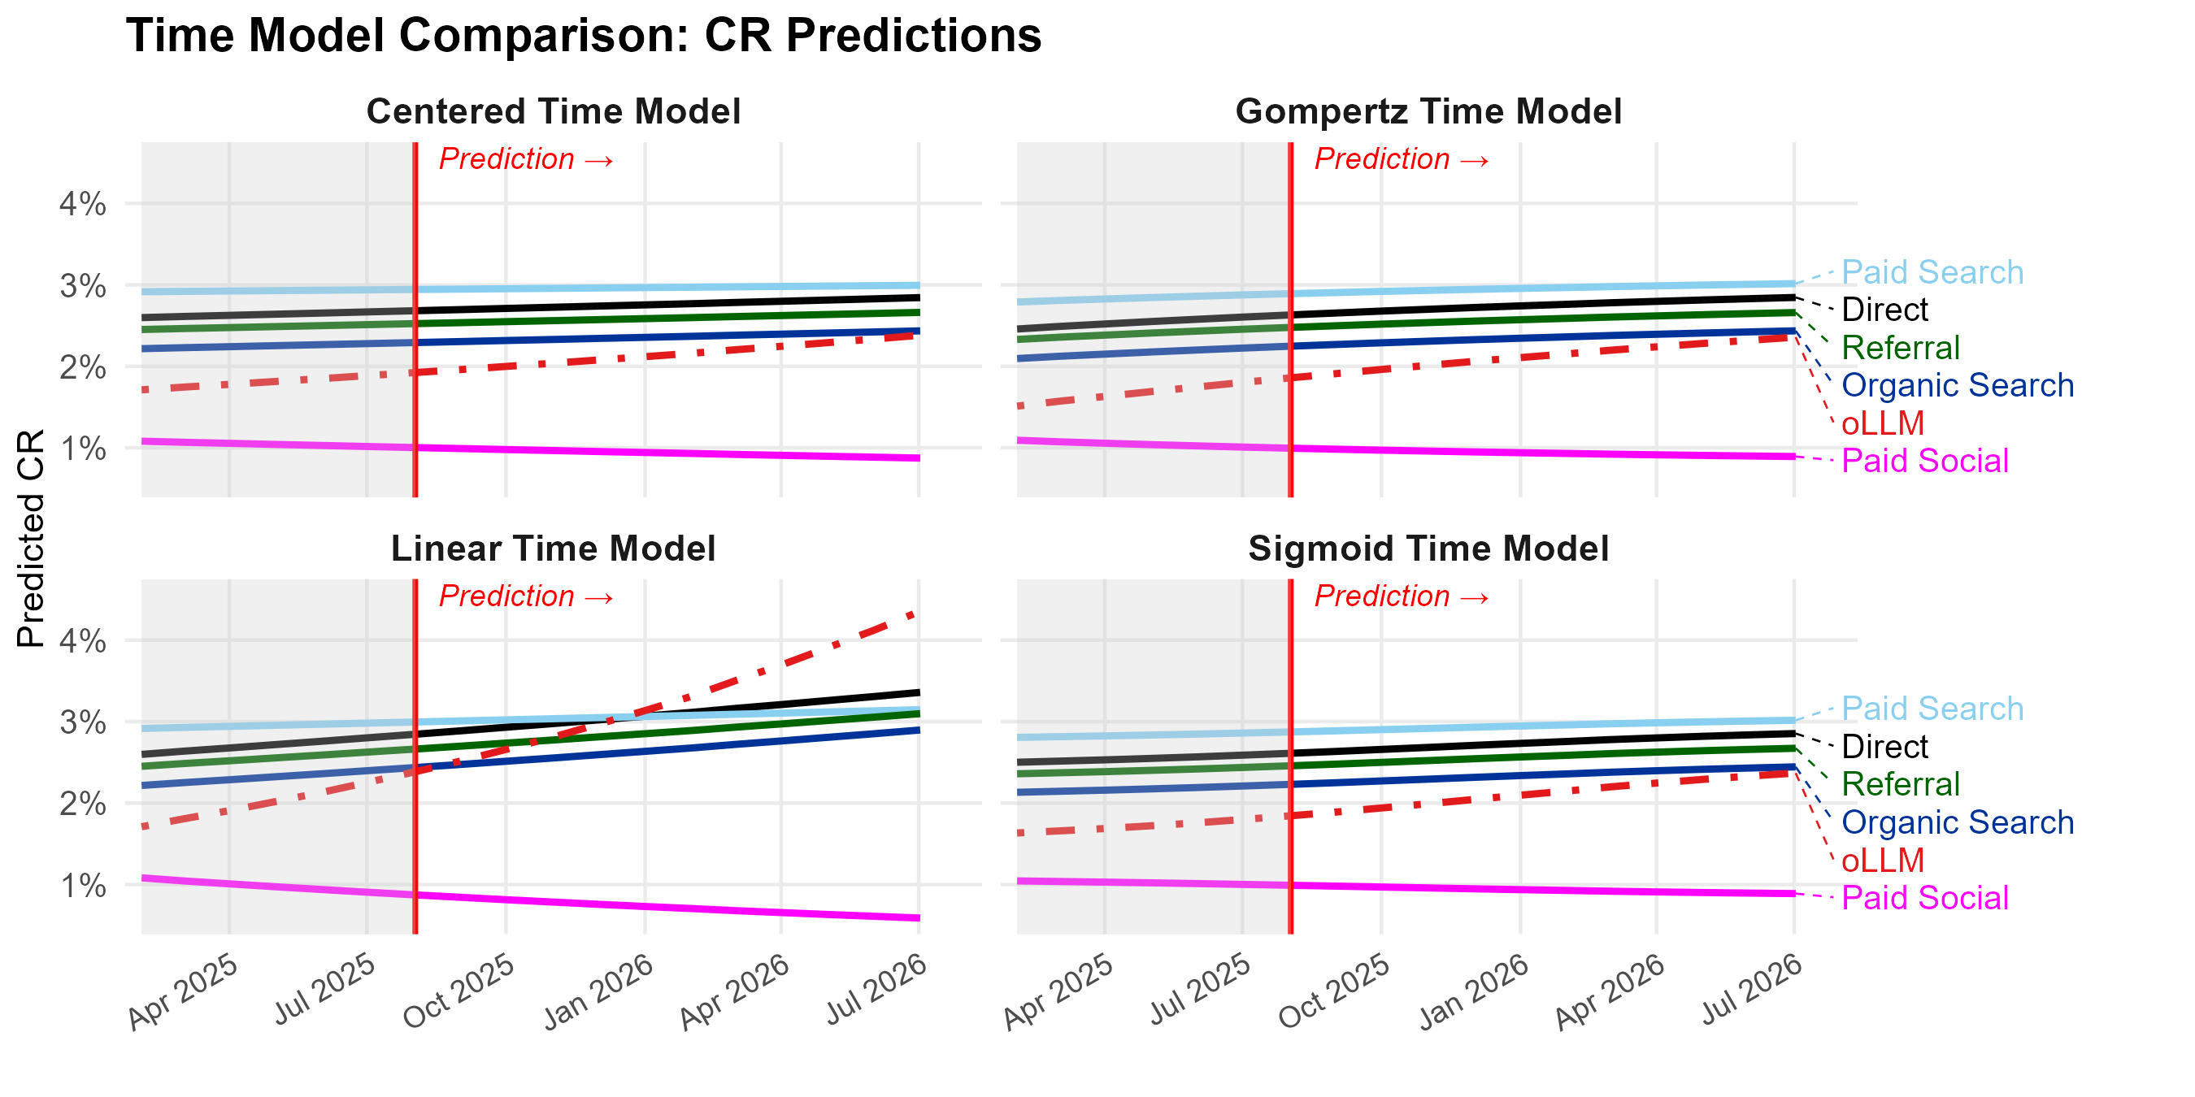
SECTION 5 · TEMPORAL DYNAMICS
Projection: conversion rate keeps closing the gap
Takeaway: Three of four models predict oLLM's conversion rate approaches — but does not reach — organic search within 12 months. Only the optimistic linear model shows it overtaking.
Figure 18. Projected CR development by channel, four trend models.
Maximilian Kaiser & Christian Schulze · ChatGPT Referrals to E-Commerce Websites · Marketing Science · organicllm.org
38
Notes:
The convergence question, answered. In three of four models oLLM's conversion rate rises toward organic search (the next-best channel) but doesn't catch it within a year; only the aggressive linear/logit model has it overtaking. Bottom line for students: oLLM is closing the conversion gap, and under optimistic assumptions could match organic search — but that's the best case, not the base case.

Slide 39
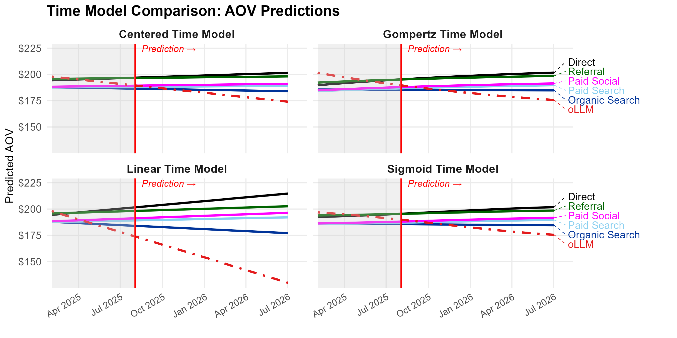
SECTION 5 · TEMPORAL DYNAMICS
Projection: the order-value gap keeps widening
Takeaway: Across models, oLLM's order value keeps diverging downward — the widening AOV gap is the brake on revenue per session.
Figure 19. Projected AOV development by channel.
Maximilian Kaiser & Christian Schulze · ChatGPT Referrals to E-Commerce Websites · Marketing Science · organicllm.org
39
Notes:
The brake. Every model projects oLLM's order value continuing to fall away from the pack. So even as conversion converges, the basket-size gap widens — and the two partly cancel in revenue terms. This is the quantitative version of 'higher conversion but lower order value,' and it's the thread that ties to the mechanism in the next section.

Slide 40
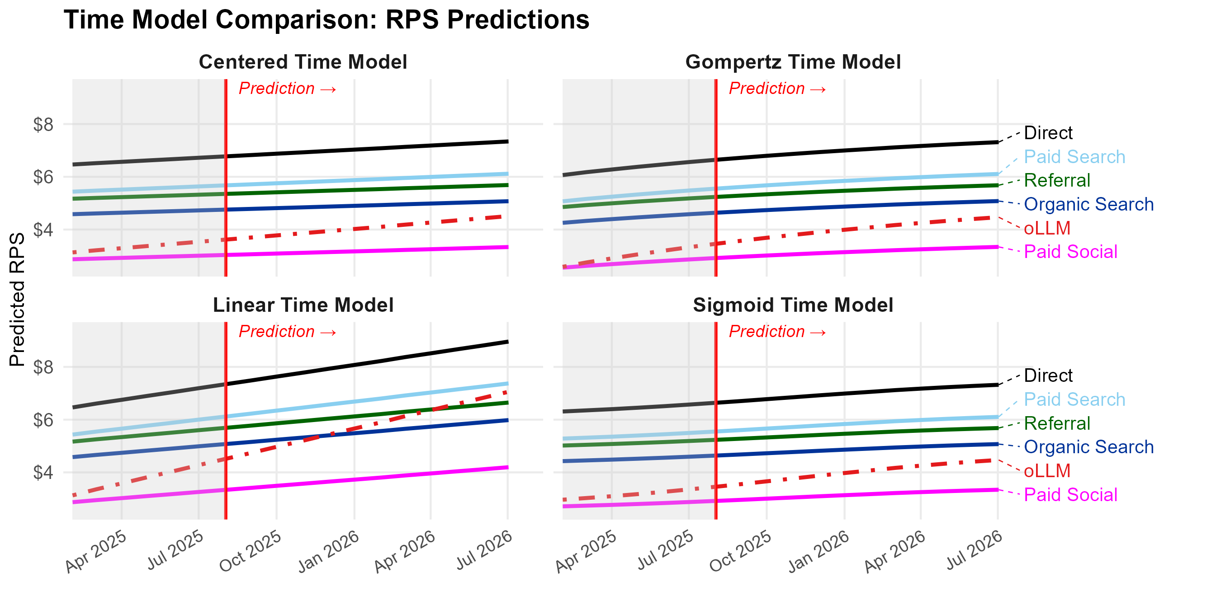
SECTION 5 · TEMPORAL DYNAMICS
Projection: revenue per session improves only moderately
Takeaway: Net result: revenue per session improves moderately, reaching organic-search parity only under the most aggressive (linear) scenario.
Figure 20. Projected RPS development by channel.
Maximilian Kaiser & Christian Schulze · ChatGPT Referrals to E-Commerce Websites · Marketing Science · organicllm.org
40
Notes:
The net projection on the metric that matters most. RPS rises, but parity with the next-best channel (organic search) only happens in the most optimistic scenario; the conservative models keep oLLM below it through the horizon. So the measured, defensible claim is: oLLM is on an improving path, but 'catching up' on the value of a session within a year requires the rosy assumptions.

Slide 41
SECTION 5 · TEMPORAL DYNAMICS
Temporal takeaway
The signature of the whole paper: conversion rate ↑, order value ↓, revenue per session ↑ only modestly.
Projections: the conversion gap narrows, but the order-value gap widens.
Parity with the next-best channel (organic search) is a best-case, not a base-case.
The same rising-CR / falling-AOV pattern reappears across websites — which is the clue to the mechanism.
Hold this pattern
Rising conversion + falling order value. It returns in the heterogeneity analysis across audiences — and that parallel is what points to the underlying mechanism.
Maximilian Kaiser & Christian Schulze · ChatGPT Referrals to E-Commerce Websites · Marketing Science · organicllm.org
41
Notes:
Summarize and hand off to the heterogeneity section. The key move: the very same fingerprint (more conversions, smaller baskets) shows up BOTH over time and across audiences with different proficiency. Two independent views agreeing is what makes the mechanism story credible.

Slide 42
06
SECTION 6
Why outcomes vary across websites
Two testable mechanisms — product complexity (usefulness) and consumer LLM proficiency — and what they reveal about where oLLM already works.
Notes:
The most strategically useful section. Descriptive, not causal — but it tells retailers where oLLM pays off today and points to the mechanism behind the trajectory.

Slide 43
SECTION 6 · HETEROGENEITY
Two mechanisms the data can test
Why might oLLM underperform? The paper explores two mechanisms it can actually test in the data.
(1) Usefulness: LLMs help most when a purchase needs information synthesis and deliberation; for simple products, conversation may add friction, not value.
(2) Proficiency: consumers are still learning to shop with LLMs; outcomes should improve as proficiency grows.
Both are explored via cross-website variation.
A careful caveat
These splits compare different websites (e.g., complex- vs simple-product sites), not the same users randomized — the data can't segment by product/customer and channel at once, so all heterogeneity is necessarily between-website. They suggest mechanisms; they don't prove them.
Maximilian Kaiser & Christian Schulze · ChatGPT Referrals to E-Commerce Websites · Marketing Science · organicllm.org
43
Notes:
Set up the two mechanisms and the caveat. Usefulness: oLLM should shine where decisions are hard (synthesis, comparison) and add little for simple buys. Proficiency: as people learn to shop with LLMs, outcomes should improve. Stress the design limitation: these are between-website comparisons, so they're suggestive, not causal. That honesty is part of the teaching value.

Slide 44
SECTION 6 · HETEROGENEITY
Mechanism 1: product complexity
Complexity proxy: each website's category, rated by three LLMs (Claude, Gemini, ChatGPT).
High-complexity: heavy industry, business & consumer services, vehicles, law, finance, jobs.
Low-complexity: reference materials, news, sports, arts & entertainment, adult.
Hypothesis: oLLM is more useful where purchases need synthesis and deliberation.
4.6×
higher oLLM traffic share on high-complexity-category sites vs low
Maximilian Kaiser & Christian Schulze · ChatGPT Referrals to E-Commerce Websites · Marketing Science · organicllm.org
44
Notes:
Introduce the complexity split. The 4.6× difference in oLLM traffic SHARE (before we even look at conversion) is itself evidence for the usefulness hypothesis: people already gravitate to oLLM more for complex categories. Note the proxy is at the website-category level, rated by three different LLMs to reduce idiosyncrasy. The next three slides show conversion, order value, and revenue per session under this split.

Slide 45
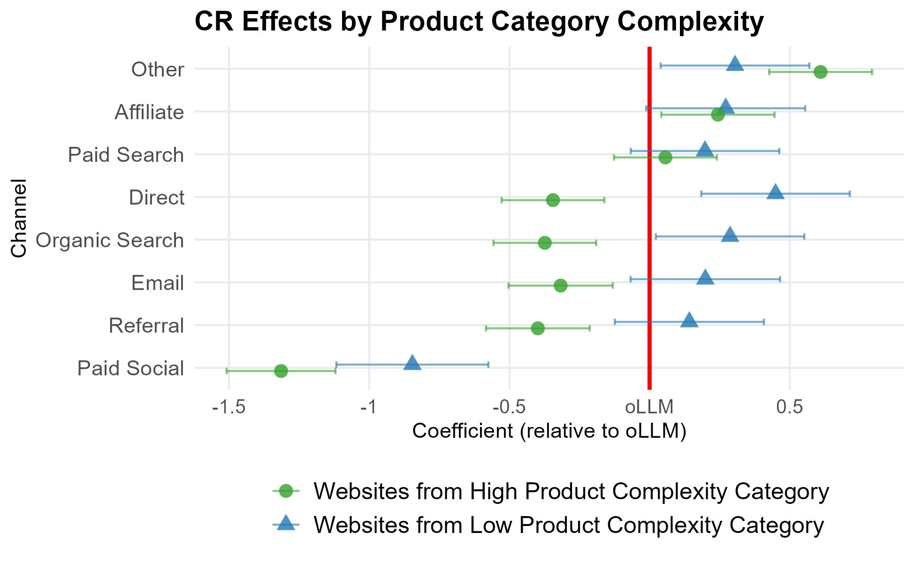
SECTION 6 · HETEROGENEITY
Complexity & conversion — oLLM wins on complex sites
Takeaway: On high-complexity sites (green), oLLM's conversion rate beats direct, organic search, email, referral, and paid social — they fall left of the oLLM line. On simple-product sites (blue), every channel beats oLLM.
Figure 21. CR by channel (log-odds), split by website category complexity. Left of the red line = below oLLM.
Maximilian Kaiser & Christian Schulze · ChatGPT Referrals to E-Commerce Websites · Marketing Science · organicllm.org
45
Notes:
The most striking heterogeneity result. Read the green markers (high-complexity sites): direct, organic search, email, and referral sit to the LEFT of the oLLM line — meaning oLLM out-converts them where products are complex. The blue markers (simple products) are all to the right — oLLM trails everyone. This is the strategic punchline for retailers: for considered, complex purchases, oLLM is already a genuinely competitive conversion channel.

Slide 46
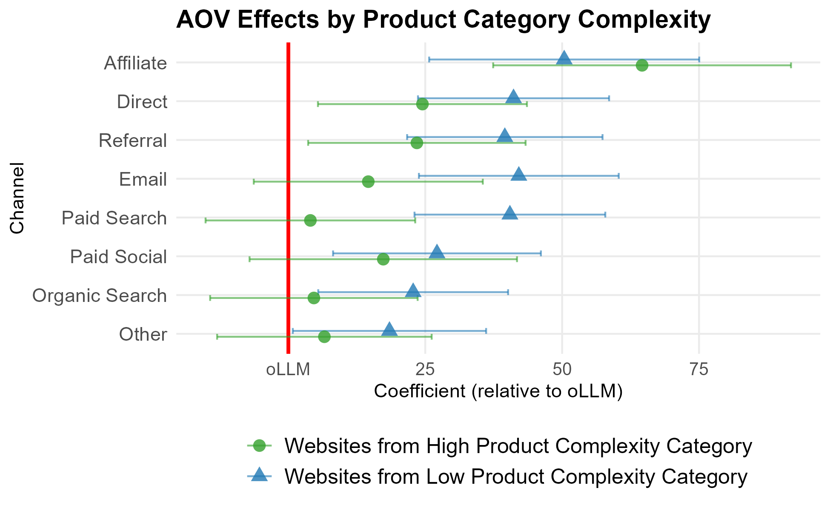
SECTION 6 · HETEROGENEITY
Complexity & order value — the gap narrows
Takeaway: Order-value gaps narrow on high-complexity sites — oLLM's disadvantage on basket size shrinks where products are complex.
Figure 22. AOV by channel, split by website category complexity.
Maximilian Kaiser & Christian Schulze · ChatGPT Referrals to E-Commerce Websites · Marketing Science · organicllm.org
46
Notes:
Order value also improves for oLLM in complex categories — the gaps versus other channels narrow. This fits the usefulness story: for big, considered purchases, oLLM both converts and carries reasonable basket value. Flag the tension to revisit: complexity NARROWS the AOV gap, whereas time and proficiency WIDEN it. Don't paper over that — it's a genuine open question in the paper.

Slide 47
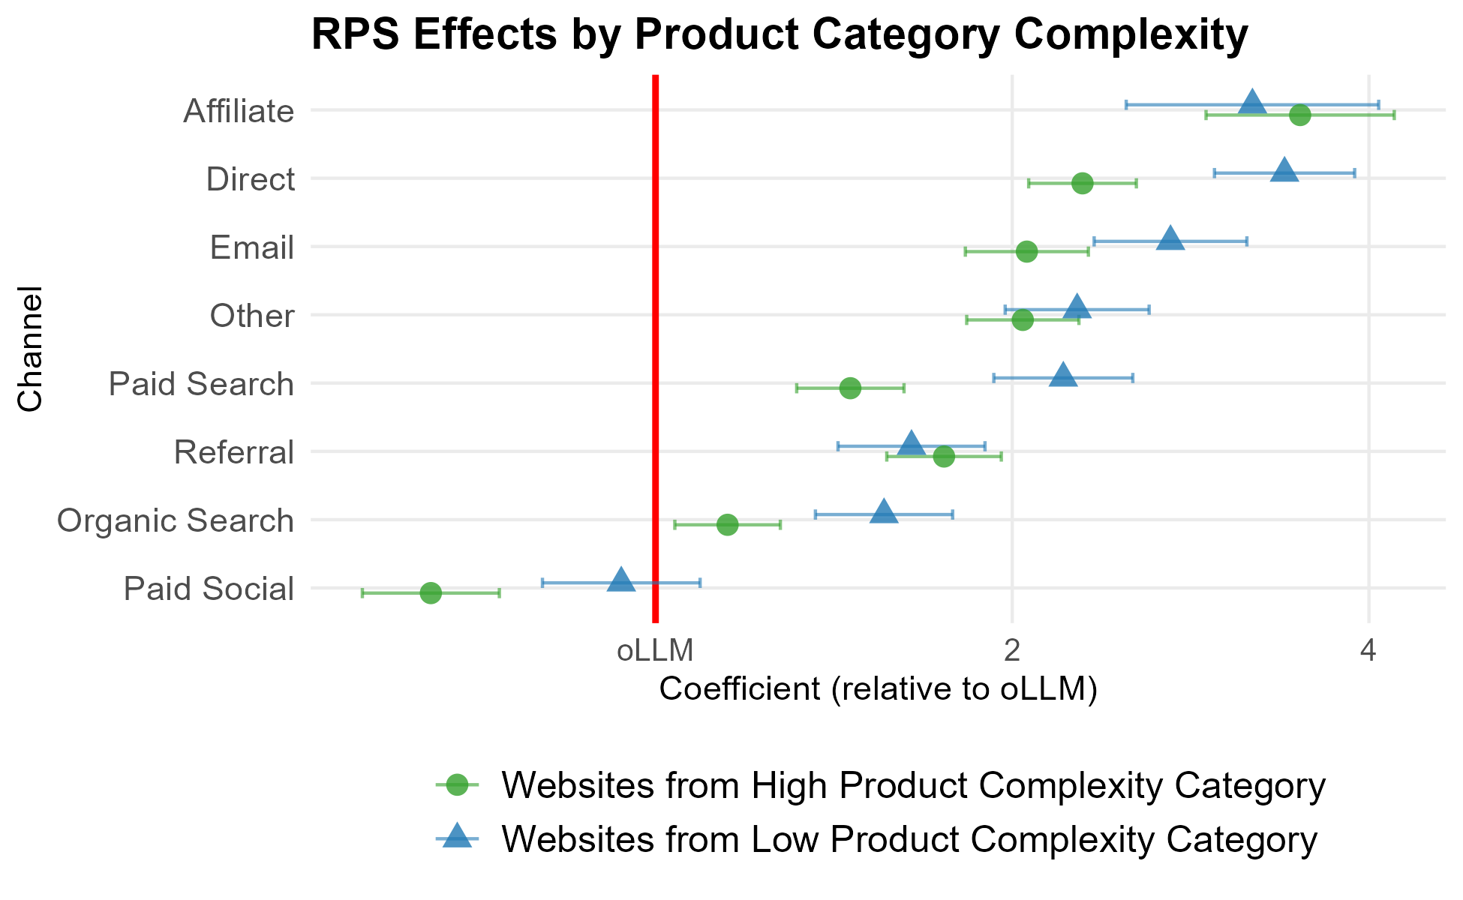
SECTION 6 · HETEROGENEITY
Complexity & revenue per session — closest to search here
Takeaway: Revenue per session moves closer to organic and paid search on high-complexity sites — oLLM's strongest relative showing anywhere in the paper.
Figure 23. RPS by channel, split by website category complexity.
Maximilian Kaiser & Christian Schulze · ChatGPT Referrals to E-Commerce Websites · Marketing Science · organicllm.org
47
Notes:
The value-per-session view of the complexity split. On complex-product sites, oLLM's RPS approaches organic and paid search — the closest oLLM gets to the strong channels anywhere in the study. Together, Figures 21–23 make the cleanest practical claim in the paper: oLLM is a high-intent complement to search for complex, considered purchases, today, not someday.

Slide 48
SECTION 6 · HETEROGENEITY
Complexity — caveats worth teaching
The complexity story fits the usefulness hypothesis: oLLM earns its keep where decisions are hard.
But a tension: complexity narrows the order-value gap, while time and proficiency (next) widen it. Not all signals point the same way.
A measurement caveat: what counts as a 'conversion' differs across categories (a subscription vs a cart checkout), so the split partly reflects conversion-type differences.
Teaching hook
Ask students: if oLLM is best for complex purchases, which categories should retailers prioritize for generative-engine optimization (GEO) today?
Maximilian Kaiser & Christian Schulze · ChatGPT Referrals to E-Commerce Websites · Marketing Science · organicllm.org
48
Notes:
Don't oversell the complexity result. Two honest caveats: (1) it points the opposite way to the proficiency/temporal AOV evidence, so the AOV story is genuinely unsettled; (2) 'conversion' isn't identical across categories — a finance site's conversion (open an account) differs from apparel (checkout), so some of the split is conversion-type, not LLM usefulness per se. The teaching hook turns this into a strategy discussion about where GEO investment pays off first.

Slide 49
SECTION 6 · HETEROGENEITY
Mechanism 2: consumer LLM proficiency
Proficiency proxied two ways at the website level: share of 'technophile' visitors (Google affinity segments) and average visitor age.
More-proficient audiences should extract more value from LLM shopping.
Both proxies line up: oLLM's traffic share is far higher where audiences skew technophile or younger.
3.8×
greater oLLM share — top vs bottom technophile quartile
5.5×
greater oLLM share — younger- vs older-visitor sites
Maximilian Kaiser & Christian Schulze · ChatGPT Referrals to E-Commerce Websites · Marketing Science · organicllm.org
49
Notes:
Introduce the proficiency split with two proxies. Again, before looking at conversion, the traffic SHARE already moves a lot: 3.8× more oLLM on technophile-heavy sites, 5.5× more on younger-skewing sites. Proficient and younger audiences are simply using oLLM more. Set up the key question: among those proficient audiences, does oLLM also PERFORM better? The next three slides answer it — and reveal the mechanism.

Slide 50
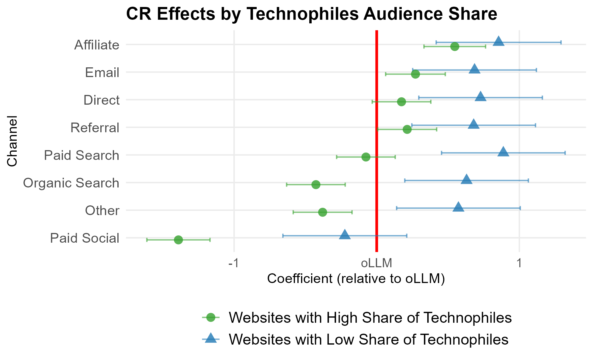
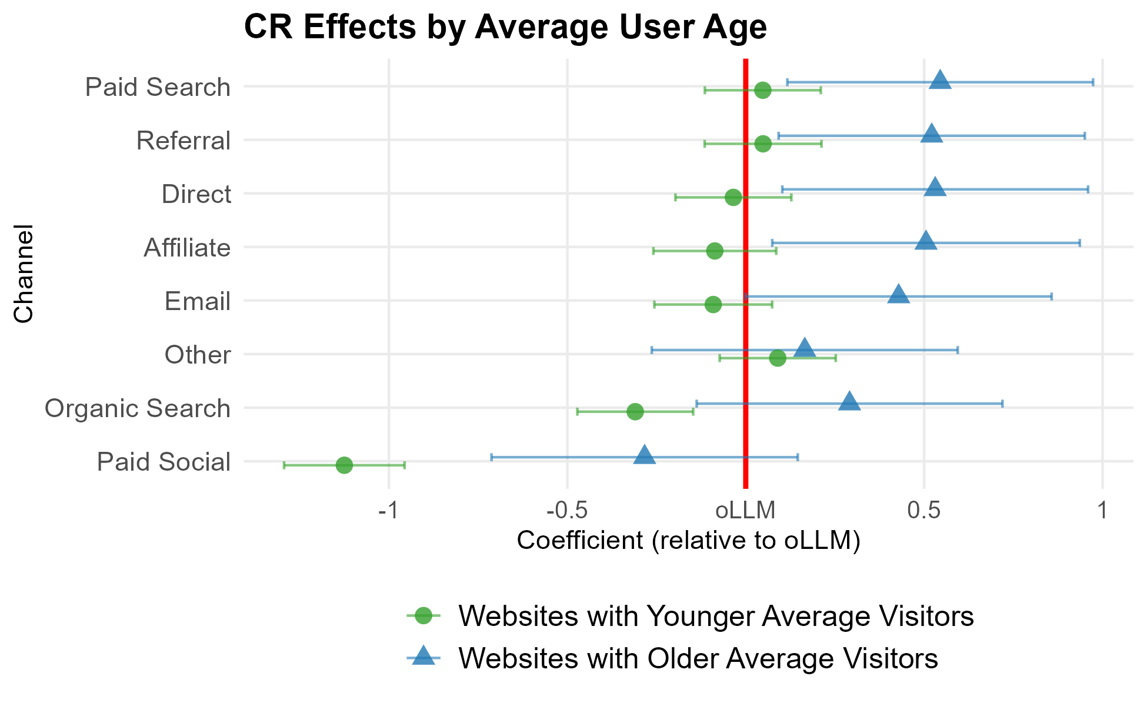
SECTION 6 · HETEROGENEITY
Proficiency & conversion — oLLM can beat organic search
Takeaway: Where audiences are more LLM-proficient, oLLM's conversion gaps shrink — and oLLM even exceeds organic search in both the technophile and the younger-visitor splits.
(a) Technophile split
(b) Age split
Figure 24. CR by channel (log-odds), split by consumer LLM-proficiency proxies.
Maximilian Kaiser & Christian Schulze · ChatGPT Referrals to E-Commerce Websites · Marketing Science · organicllm.org
50
Notes:
Conversion under the proficiency split. In both the technophile and younger-visitor cuts, oLLM's conversion rate rises enough to surpass organic search — the channel it merely tied with on average. Message: oLLM's 'weak conversion' is partly an adoption-stage effect. Where users are fluent, it already converts at search-competitive rates. But watch order value — next slide.

Slide 51
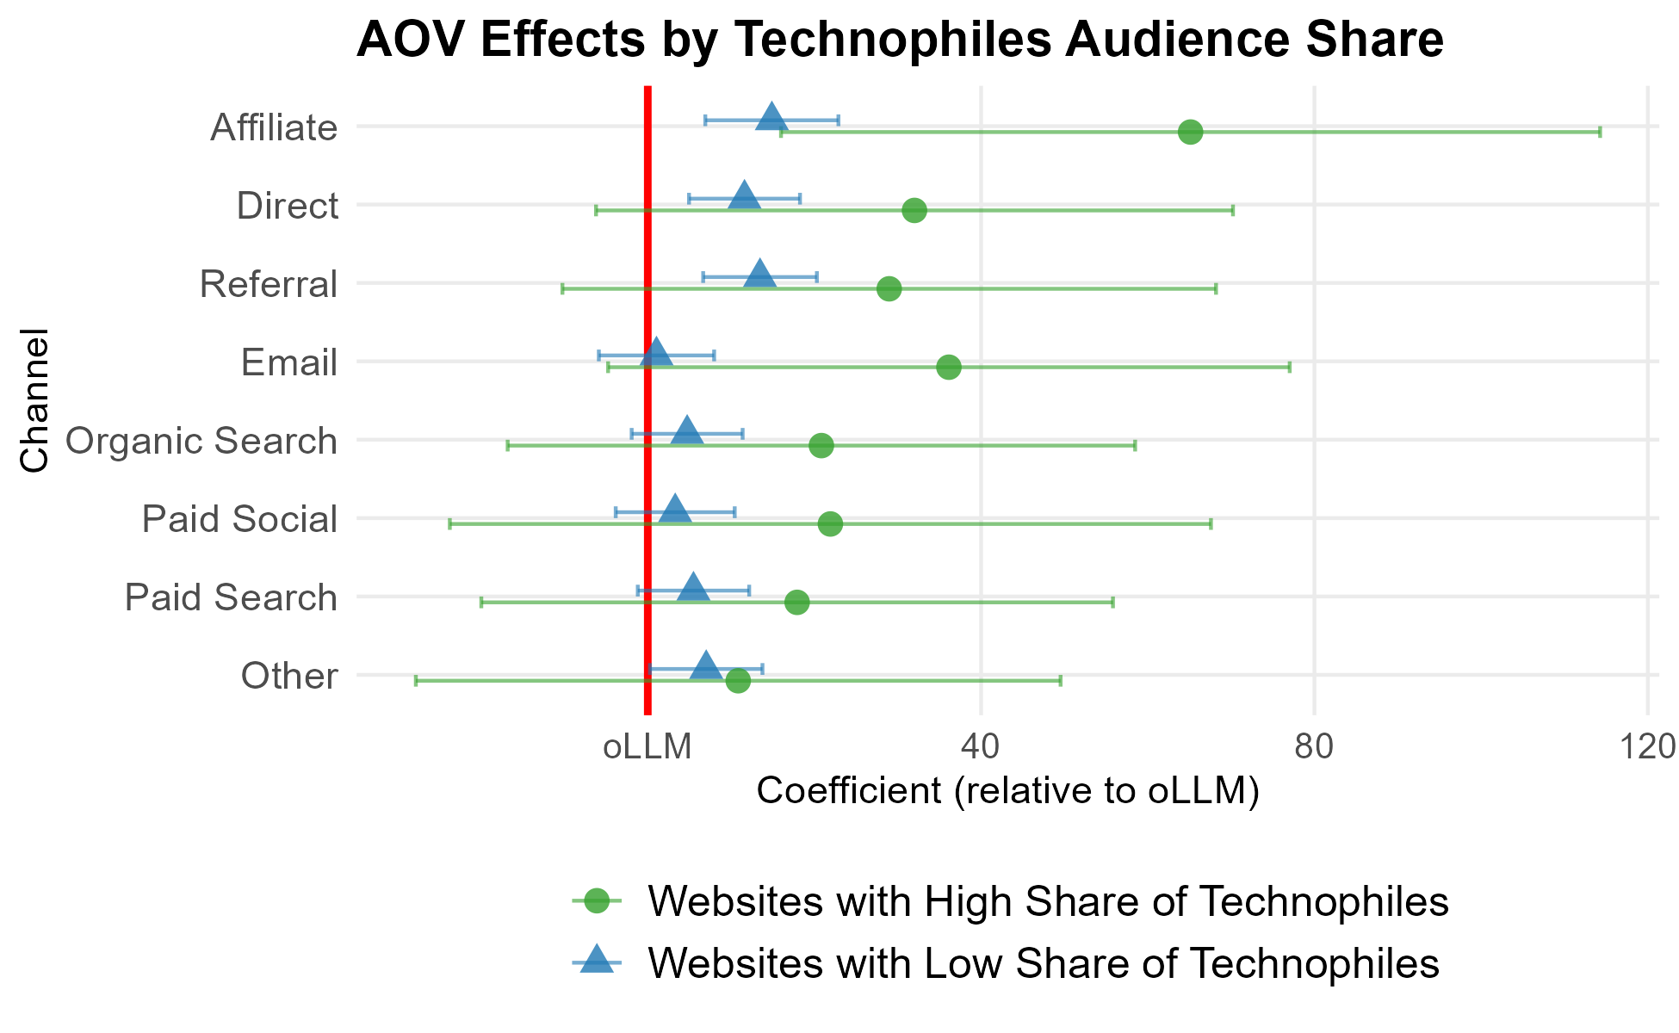
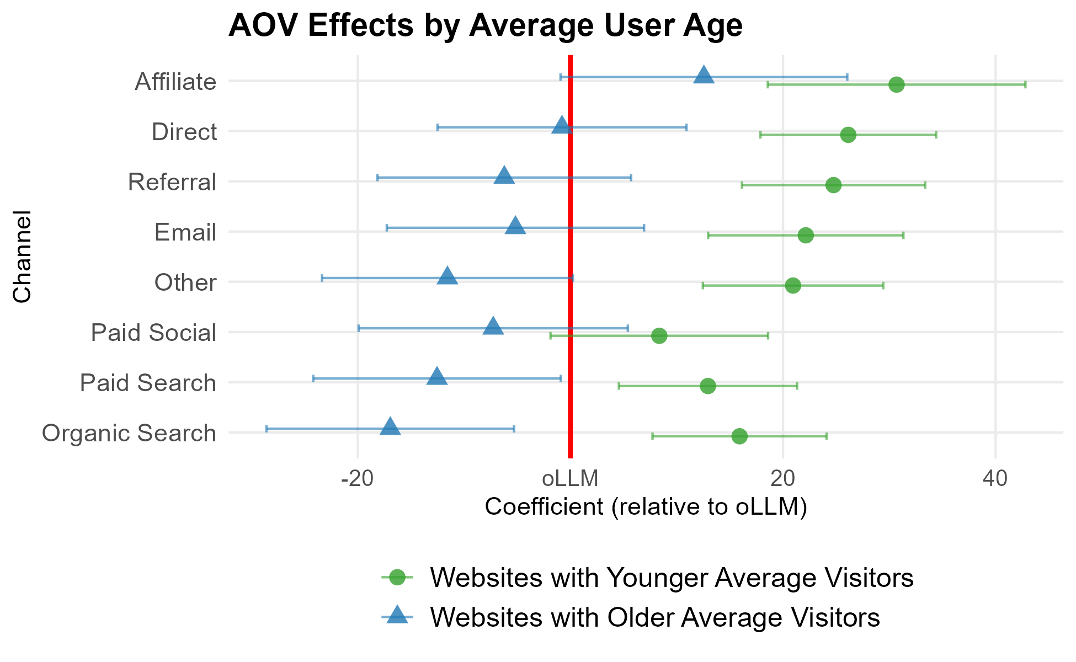
SECTION 6 · HETEROGENEITY
Proficiency & order value — the gap widens
Takeaway: Order value moves the other way: among more-proficient audiences the gap widens — proficient shoppers convert more, yet spend less per order.
(a) Technophile split
(b) Age split
Figure 25. AOV by channel, split by consumer LLM-proficiency proxies.
Maximilian Kaiser & Christian Schulze · ChatGPT Referrals to E-Commerce Websites · Marketing Science · organicllm.org
51
Notes:
The crucial counterpoint. Exactly where conversion improves (proficient audiences), order value gets WORSE relative to other channels. So proficiency buys more conversions but smaller baskets. This is the same rising-CR/falling-AOV signature as the time trend — now in the cross-section. Two independent cuts of the data showing the same lopsided pattern is the heart of the mechanism argument.

Slide 52
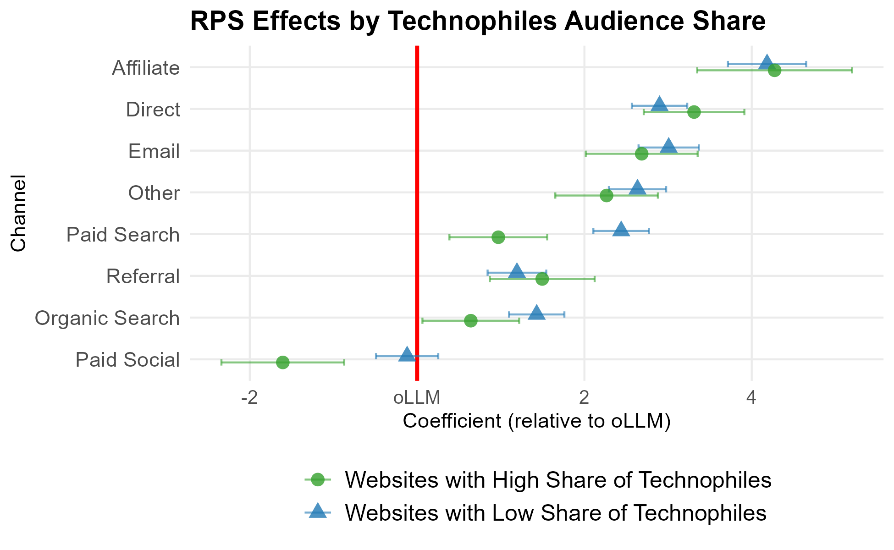
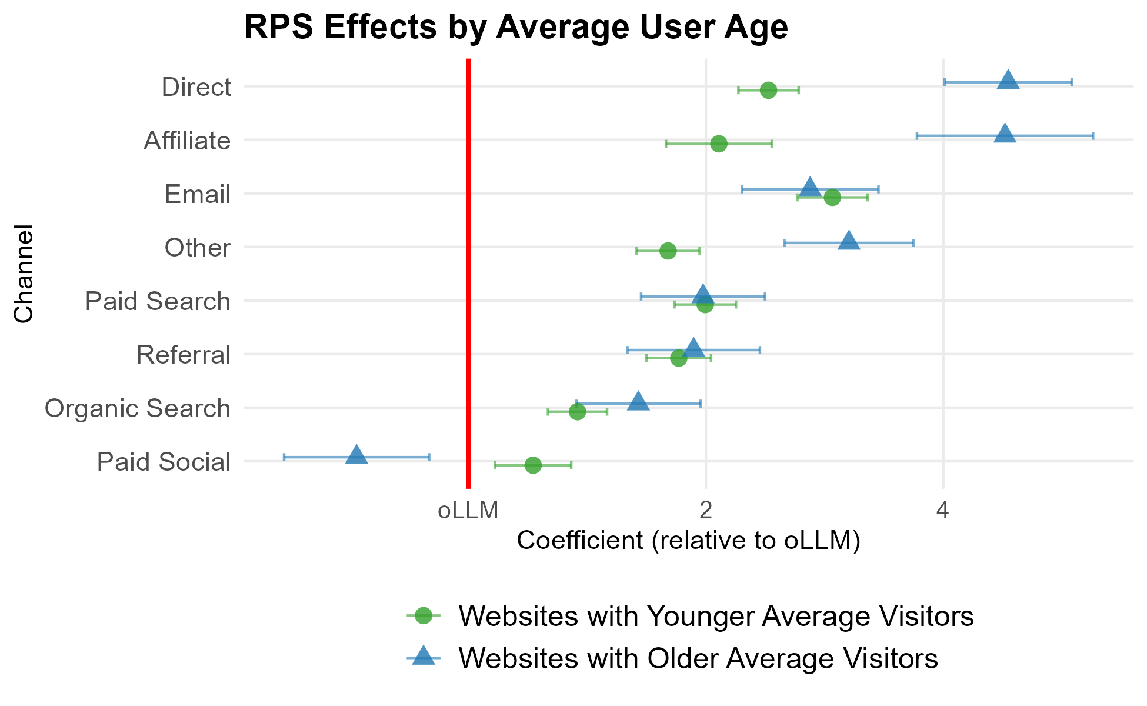
SECTION 6 · HETEROGENEITY
Proficiency & revenue per session — mixed but improving
Takeaway: Revenue per session is mixed but improved: oLLM gains on paid and organic search among technophile sites, and on direct/affiliate/other among younger-visitor sites.
(a) Technophile split
(b) Age split
Figure 26. RPS by channel, split by consumer LLM-proficiency proxies.
Maximilian Kaiser & Christian Schulze · ChatGPT Referrals to E-Commerce Websites · Marketing Science · organicllm.org
52
Notes:
The net value-per-session view of the proficiency split. The rising conversion and falling order value partly offset, so RPS improvements are real but mixed across channels. The consistent story across Figures 24–26: proficiency clearly helps conversion, hurts basket size, and nets out to a modest value gain — exactly mirroring the temporal section.

Slide 53
SECTION 6 · HETEROGENEITY
The mechanism: growing consumer LLM proficiency
The same signature appears in both the time trend and the proficiency cross-section: conversion up, order value down.
That parallel is the paper's central clue: growing consumer LLM proficiency is the most likely driver of oLLM's evolution.
Plausible reading: as shoppers get fluent, they convert more often but buy more narrowly — more targeted purchases, or sharper price awareness from LLM transparency.
Two patterns, one cause
Temporal (over months) and cross-sectional (across audiences) evidence rarely line up by accident. When they do, it's the strongest descriptive case you can make for a mechanism without an experiment.
Maximilian Kaiser & Christian Schulze · ChatGPT Referrals to E-Commerce Websites · Marketing Science · organicllm.org
53
Notes:
The synthesis of the whole heterogeneity section, and arguably the paper's most important inference. Because the identical pattern (more conversions, smaller baskets) shows up both as the channel ages AND as you move toward more-proficient audiences, the most parsimonious explanation is growing consumer proficiency. Offer the two sub-mechanisms: targeting (fluent users buy exactly what they need, less exploratory add-on buying) and price transparency (LLMs surface cheaper alternatives). Both are testable in future work.

Slide 54
07
SECTION 7
Key insights & implications
Two patterns to carry in — a still-small, second-from-bottom channel today, on an improving but lopsided trajectory. What it means for retailers and for LLM platforms (including the looming shift to paid LLM advertising), plus the limitations.
Notes:
Land the plane. Synthesize the two patterns, translate to action for retailers and platforms, flag the paid-ads wildcard, and be honest about limitations.

Slide 55
SECTION 7 · IMPLICATIONS
For retailers
oLLM's value today is concentrated in high-complexity categories — where shoppers want comparison and guidance.
There, oLLM combines comparatively strong conversion and revenue per session with a favorable bounce rate: a high-intent complement to search, even at low volume.
For simple, routine purchases, low share and weak conversion/revenue mean limited near-term upside from optimizing for oLLM.
GEO, concretely
Sell complex/considered products? oLLM is worth early generative-engine-optimization investment. Sell simple/routine goods? Watch and wait — the volume isn't there yet.
Maximilian Kaiser & Christian Schulze · ChatGPT Referrals to E-Commerce Websites · Marketing Science · organicllm.org
55
Notes:
Translate the research into a retailer playbook. The actionable split: complex/considered categories should invest now in being recommended and linked by LLMs (GEO); simple/routine categories should monitor but not over-invest. Tie back to Figures 21–23: this isn't a hunch, it's where the data already show oLLM competing.

Slide 56
SECTION 7 · IMPLICATIONS
For LLM platforms — and the paid-ads wildcard
The weakness concentrates in simple, routine purchases — exactly what platforms are now targeting.
Initiatives since the study window: instant checkout and agentic shopping (and on-site agents like Amazon's Rufus) to remove the friction of leaving the chat.
The bigger shift is paid: ChatGPT ads (pLLM) weren't live during the study.
Depending on design, sponsored placements could cut friction for simple buys — or erode the trust and usefulness that make organic referrals work.
Even organic oLLM isn't bias-free: recommendations may carry less advertising bias than paid channels, yet could favor brands well-represented in training/retrieved data — a different bias, not no bias.
Watch this next
Everything in this deck is organic oLLM. Paid LLM traffic (pLLM) could redefine the channel's economics — the single most important thing to watch next.
Maximilian Kaiser & Christian Schulze · ChatGPT Referrals to E-Commerce Websites · Marketing Science · organicllm.org
56
Notes:
The forward-looking implication. Platforms are attacking oLLM's exact weak spot (routine purchases) with checkout and agents. And the elephant: paid placements. The study window predates ChatGPT ads, so everything here is the organic baseline. Leave students with the open strategic question: will pLLM make the channel bigger and more commercial, or will ads degrade the trust that currently makes oLLM clicks high-quality?

Slide 57
SECTION 7 · LIMITATIONS
Limitations — read every result through these
Descriptive, not causal — vulnerable to differences across channels' users and situations.
Last-click attribution understates oLLM's upper-funnel role (users likely verify LLM picks via search/retailer sites, which then take the conversion credit).
Complexity and proficiency are website-level proxies, not product- or person-level.
The channel evolves fast — 12 months captures the initial phase; the patterns may not persist.
What would settle it
Multi-touch attribution or on-site experiments could isolate oLLM's upper-funnel contribution and turn these descriptive patterns into causal estimates.
Maximilian Kaiser & Christian Schulze · ChatGPT Referrals to E-Commerce Websites · Marketing Science · organicllm.org
57
Notes:
Be upfront about limits — it strengthens the credible parts. The most important one is attribution: last-click almost certainly UNDERSTATES oLLM, because inspiration that happens in the chat but converts later elsewhere is credited to the other channel. Good discussion prompt: design a study that would measure oLLM's true upper-funnel contribution (answer: multi-touch attribution or a website-level experiment).

Slide 58
SECTION 7 · WRAP-UP
Five things students should leave with
New but tiny: oLLM appeared in August 2024 and is still under 0.2% of sessions.
Middling quality today: it out-converts only paid social; bounce rate is its bright spot.
Resist the hype: rigorous modeling overturns cherry-picked case studies claiming oLLM beats search.
Context-dependent: oLLM is genuinely competitive for complex products and proficient audiences.
Improving, with a catch: conversion rises while order value falls — modest net gains, with paid ads the big unknown ahead.
Maximilian Kaiser & Christian Schulze · ChatGPT Referrals to E-Commerce Websites · Marketing Science · organicllm.org
58
Notes:
The recap slide. If students remember five things, these are them. Note the deliberate balance: neither 'AI is overhyped' nor 'AI changes everything,' but a calibrated read — a real, improving, still-small channel that already works in specific niches. End by pointing to the open questions (paid ads, causal attribution, the AOV puzzle) as research and strategy opportunities.

Slide 59

CITE & REUSE
Cite, read, and reuse
How to cite
Kaiser, M., & Schulze, C. (forthcoming). ChatGPT Referrals to E-Commerce Websites: How Do LLMs Compare Against Traditional Channels? Marketing Science.
Links
Marketing Science (DOI)
|
SSRN preprint
|
organicllm.org
Christian Schulze · LinkedIn
|
Maximilian Kaiser · LinkedIn
organicllm.org
Research paper, background info, and the latest version of these slides
These teaching slides are provided for non-commercial educational use. Figures are the authors' own, reproduced from the paper. License: CC BY-NC 4.0. Please keep attribution to the authors.
Notes:
Closing slide. Point instructors to the open SSRN preprint and the Marketing Science version of record, and invite them to cite the paper and connect with the authors. The QR code goes to organicllm.org/slides — the paper's companion site with the open-access PDF, the press coverage, and the latest version of this deck; leave this slide on screen at the end so the audience can scan it.

Slide 60
FOR THE CURIOUS · SAME PAPER, MORE DEPTH
Online Appendix
Complete category & geographic coverage, full methodology and weighting, robustness across every metric, the quartile tables behind the heterogeneity figures, the reconciliation with industry reports, and directions for future research.
Notes:
This appendix is reference material for the most advanced audiences (doctoral, methods-focused) or for answering the questions that always come up. It is optional — the main deck (Sections 1–7) stands on its own. Highlights to point people to: the full category coverage (Appendix A — including B2B), and the reconciliation with the hyped industry reports (Appendix E).

Slide 61
APPENDIX A · COVERAGE
24 categories — far beyond Amazon-style retail
The 973 sites span all 24 SimilarWeb top-level categories — this is not only consumer retail.
B2B & industrial are fully included — e.g. Business & Consumer Services and Heavy Industry & Engineering (example sites of these categories: indeed.com, paypal.com, fedex.com; caterpillar.com, boeing.com, ge.com).
Also Finance, Law & Government, Vehicles, Jobs & Career, Travel, Health and Education (example sites: chase.com, coinbase.com; irs.gov, gov.uk; tesla.com, ford.com).
“Conversion” is category-appropriate: a retail checkout, a finance wire or insurance premium, a SaaS subscription, a government fee — see the conversion-logic and the full category table next.
Two clarifications
1. “Is this just online shops?” No — B2B, industrial, financial, government and service categories are all in the panel, each with its own conversion.
2. The domains shown are SimilarWeb
examples of each category — illustrative of the kind of site, not necessarily sites in this dataset.
Maximilian Kaiser & Christian Schulze · ChatGPT Referrals to E-Commerce Websites · Marketing Science · organicllm.org
61
Notes:
Make the breadth explicit — this is the single most common misconception. The dataset is a representative cross-section of e-commerce broadly defined, not just Amazon-style retailers. The example domains are the quickest way to land the point: Boeing, Caterpillar, GE (heavy industry); LinkedIn, PayPal, FedEx, Zillow (business services); IRS, gov.uk (government). The next two slides give the full 24-category breakdown. Be clear when presenting: the named domains are SimilarWeb EXAMPLES of each category — not a claim that those specific companies are in the panel.

Slide 62
APPENDIX A · COVERAGE (TABLE A.1, 1 OF 2)
All 24 categories — volume & oLLM share (part 1)
Category | Sessions (M) | Revenue ($M) | oLLM % Sess. | oLLM % Rev.
E-commerce and Shopping | 1,201.3 | 1,915.3 | 0.05 | 0.03
Lifestyle (Fashion, Cosmetics) | 1,127.3 | 2,026.9 | 0.02 | 0.02
Business & Consumer Services | 617.8 | 780.2 | 0.10 | 0.10
Home and Garden | 531.4 | 1,410.6 | 0.03 | 0.03
Consumer Electronics | 465.6 | 758.1 | 0.20 | 0.12
Vehicles | 441.1 | 300.2 | 0.03 | 0.05
Science and Education | 249.9 | 197.4 | 0.24 | 0.12
Arts and Entertainment | 227.4 | 797.4 | 0.07 | 0.14
Finance | 227.4 | 224.0 | 0.09 | 0.06
Travel and Tourism | 184.7 | 1,279.3 | 0.10 | 0.06
Games | 163.2 | 151.7 | 0.05 | 0.02
Health | 163.1 | 350.8 | 0.04 | 0.04
Table A.1 (Feb–Aug 2025), sorted by sessions. oLLM % = ChatGPT-referral share of that category's total. Continued on the next slide.
Maximilian Kaiser & Christian Schulze · ChatGPT Referrals to E-Commerce Websites · Marketing Science · organicllm.org
62
Notes:
Part 1 of the full category list — the twelve largest by traffic. Note Business & Consumer Services (a B2B-heavy category) is the 3rd largest, with one of the higher oLLM shares (0.10%). Consumer Electronics and Science/Education show the highest oLLM shares here — more considered, information-heavy purchases.

Slide 63
APPENDIX A · COVERAGE (TABLE A.1, 2 OF 2)
All 24 categories — volume & oLLM share (part 2)
Category | Sessions (M) | Revenue ($M) | oLLM % Sess. | oLLM % Rev.
Sports | 136.1 | 417.4 | 0.02 | 0.02
Food and Drink | 104.2 | 328.9 | 0.02 | 0.02
Pets and Animals | 66.1 | 209.4 | 0.02 | 0.04
Heavy Industry & Engineering | 41.3 | 108.5 | 0.03 | 0.07
Law and Government | 23.0 | 58.5 | 0.14 | 0.05
Gambling | 8.5 | 85.0 | >0.00 | >0.00
News and Media | 7.8 | 1.6 | 0.12 | 0.24
Hobbies and Leisure | 7.4 | 34.7 | 0.06 | 0.07
Community and Society | 6.9 | 32.0 | 0.19 | 0.10
Adult | 6.4 | 16.0 | 0.01 | 0.01
Jobs and Career | 2.1 | 1.1 | 2.06 | 2.22
Reference Materials | 0.7 | 0.6 | 0.02 | 0.04
Table A.1 (continued). Jobs & Career has by far the highest oLLM share (~2%) — people increasingly start career/credential searches in an LLM.
Maximilian Kaiser & Christian Schulze · ChatGPT Referrals to E-Commerce Websites · Marketing Science · organicllm.org
63
Notes:
Part 2 completes all 24. Two things to flag: Heavy Industry & Engineering (Boeing, Caterpillar, GE) is explicitly present — proof the panel isn't only retail. And Jobs & Career stands out with a ~2% oLLM share, an order of magnitude above everything else, hinting at where LLM-led discovery is already mainstream.

Slide 64
APPENDIX A · COVERAGE (TABLE A.2)
What “conversion” means across categories
Category | Example of a conversion | Example domains
Business & Consumer Services | Premium subscription · transaction fee | indeed.com, linkedin.com, paypal.com, fedex.com, zillow.com
Heavy Industry & Engineering | Replacement part · safety-webinar fee | caterpillar.com, ge.com, boeing.com, deere.com, siemens.com
Finance | Insurance premium · wire/transfer fee | paypal.com, chase.com, bankofamerica.com, coinbase.com
Law and Government | Passport fee · document copy fee | usa.gov, irs.gov, gov.uk, uscis.gov
Vehicles | Vehicle-history report · accessory | cars.com, carmax.com, tesla.com, ford.com
Travel and Tourism | Hotel booking · flight ticket | booking.com, tripadvisor.com, airbnb.com
Health | Telehealth copay · home test kit | webmd.com, mayoclinic.org, cvs.com, walgreens.com
E-commerce and Shopping | Retail-goods purchase · gift card | amazon.com, ebay.com, walmart.com, temu.com
Example domains illustrate each category (SimilarWeb examples) — not necessarily sites in the dataset. From Table A.2 (all 24 categories in the paper). Per §6.1, “conversion” differs by category, so the complexity split partly reflects conversion-type differences.
Maximilian Kaiser & Christian Schulze · ChatGPT Referrals to E-Commerce Websites · Marketing Science · organicllm.org
64
Notes:
This is the slide that nails the B2B point: a 'conversion' is not always a shopping-cart checkout. For a government site it's a passport fee; for heavy industry, a replacement part; for finance, a wire or premium. It also flags an honest caveat the paper raises: because conversions aren't identical across categories, some of the product-complexity result could reflect conversion-type differences rather than LLM usefulness per se. The full 24-category version is in the paper.

Slide 65
APPENDIX A · COVERAGE (TABLES A.3–A.4)
Global reach: 5 continents, 49 countries
Continent | Sessions (M) | Revenue ($M) | oLLM % Sess. | oLLM % Rev.
Americas | 2,713.9 | 4,206.9 | 0.06 | 0.06
Europe | 2,134.3 | 5,202.1 | 0.06 | 0.06
Asia | 858.5 | 784.6 | 0.11 | 0.06
Oceania | 278.1 | 926.0 | 0.05 | 0.04
Africa | 57.7 | 30.1 | 0.25 | 0.09
Table A.3. Top countries by sessions: United States (1,800M), Brazil (697), United Kingdom (457), France (399), India (247), Australia (227), Germany (207), Italy, Netherlands, Thailand, Poland… 49 countries contribute ≥10M sessions each (full list, Table A.4 in the paper).
Maximilian Kaiser & Christian Schulze · ChatGPT Referrals to E-Commerce Websites · Marketing Science · organicllm.org
65
Notes:
Establish external validity geographically. The Americas and Europe dominate volume; Asia and Africa show the highest oLLM shares (early-adopter, mobile-first markets). 49 countries clear the 10M-session bar — this is a global panel, not a single-market study. The full country table is in the paper.

Slide 66
APPENDIX A · DEFINITIONS (TABLE A.5)
How each metric is defined
Variable | Definition (per website × time unit)
Conversion Rate (CR) | Transactions ÷ Sessions — the headline financial metric
Average Order Value (AOV) | Revenue ÷ Transactions (defined where transactions > 0)
Revenue per Session (RPS) | Revenue ÷ Sessions (includes realized zeros — informative about channel quality)
Bounce Rate (BR) | Bounces ÷ Sessions — leaving without a further action
Session Duration (SD) | Total time on site ÷ Sessions, in seconds
Page Views (PV) | Total page views ÷ Sessions
Controls (fixed effects) | Channel (oLLM = baseline) · Website · Device · Month
Table A.5. RPS includes zero-revenue sessions (they carry information); AOV conditions on a purchase having occurred.
Maximilian Kaiser & Christian Schulze · ChatGPT Referrals to E-Commerce Websites · Marketing Science · organicllm.org
66
Notes:
The precise definitions behind the six metrics. One subtlety worth saying aloud: RPS keeps zero-revenue sessions (a session that didn't convert is still informative about the channel), whereas AOV is only defined when a purchase happened. That asymmetry is why RPS, not AOV, is the cleanest 'value of a visit' summary.

Slide 67
APPENDIX A.4 · METHODS
Two model families, one fixed-effects structure
Rates: CR & BR
Levels: AOV · RPS · SD · PV
Quasibinomial models — sessions enter the likelihood directly.
A dispersion parameter (θ) absorbs the overdispersion in transaction/bounce counts.
Not weighted: session counts already encode precision (weighting would double-count it).
Weighted linear models in levels.
Bounded, website-relative weights cap leverage so no single large site dominates.
Reduces aggregation-induced heteroskedasticity.
Maximilian Kaiser & Christian Schulze · ChatGPT Referrals to E-Commerce Websites · Marketing Science · organicllm.org
67
Notes:
The estimating equation is the same for all outcomes: outcome = α(channel) + γ(website) + δ(device) + μ(month). The α(channel) terms — differences vs the oLLM baseline — are exactly the numbers plotted in every results figure. The split is about the error structure: bounded proportions (CR, BR) get quasibinomial with a dispersion term; dollar/engagement levels get weighted least squares. Keep this light unless the audience is methods-focused.

Slide 68
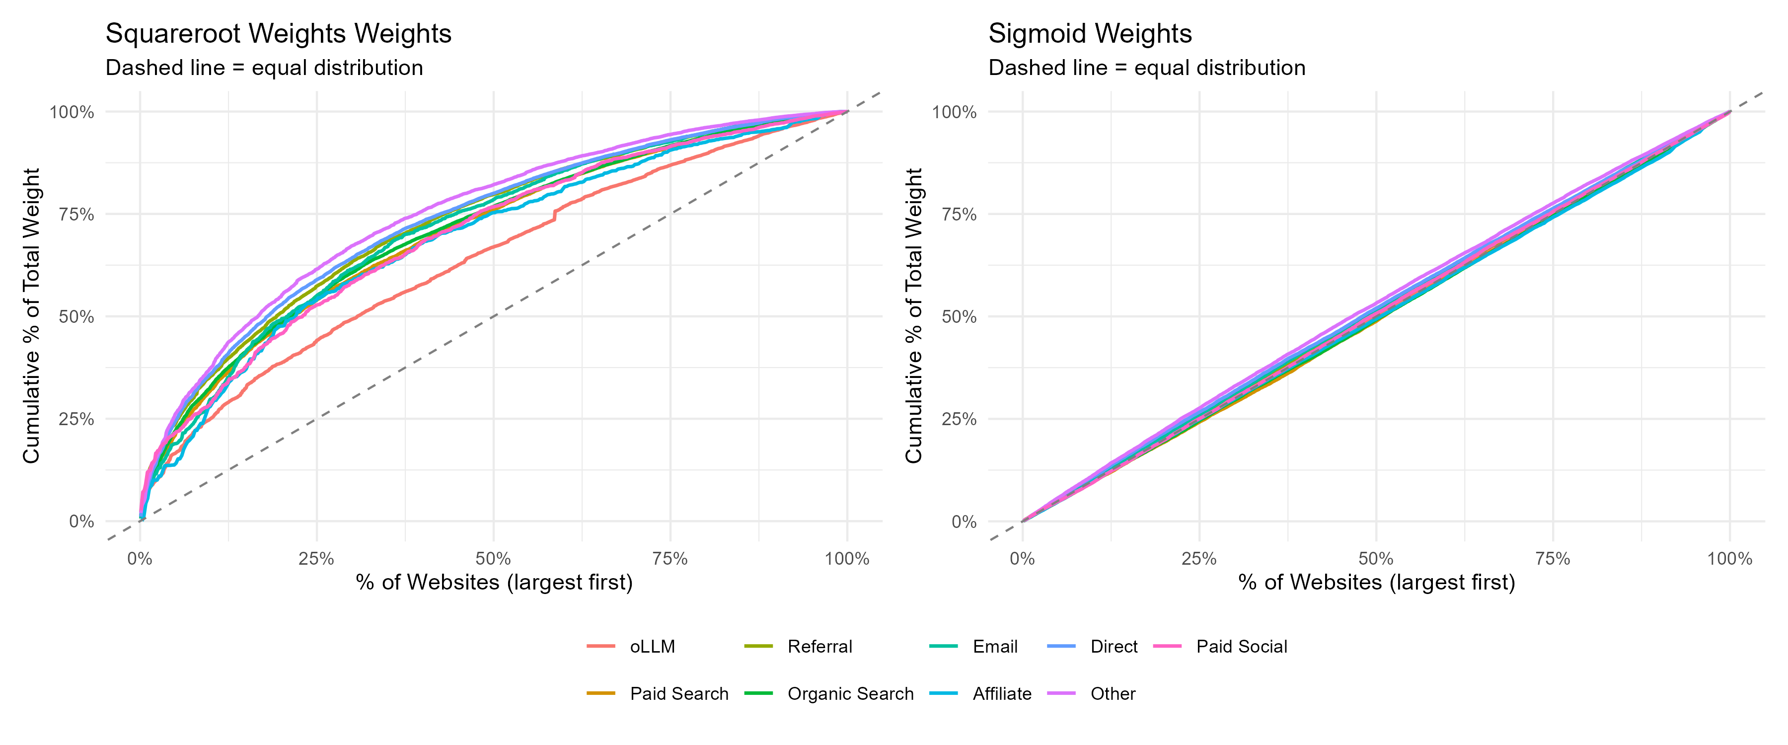
APPENDIX A.4 · METHODS
The weighting scheme — and why it matters
Takeaway: A bounded sigmoid weight balances influence across sites; a naive √sessions weight lets the largest 12.5% of sites carry ~a third of the weight — which would swamp a sparse channel like oLLM.
Figure A.1. Cumulative weight by website under the sigmoid scheme vs a square-root-of-sessions scheme.
Maximilian Kaiser & Christian Schulze · ChatGPT Referrals to E-Commerce Websites · Marketing Science · organicllm.org
68
Notes:
This is the chart that defends the modeling. Under a naive square-root-of-sessions weight (a common default), the very largest websites dominate the estimate — and they're exactly the ones with the least oLLM traffic, so oLLM's signal would be drowned out. The bounded sigmoid weight (w = 1/(1+e^-z), z = standardized session count, per site) favors more precise cells, caps any one site's leverage, and avoids raw-size bias. The flatter cumulative curve is the point.

Slide 69
APPENDIX B · ROBUSTNESS
The picture holds for every metric, not just CR
The main deck showed conversion-rate robustness across 12 specifications (Figure 14).
Here are the other five metrics — AOV, RPS, bounce rate, page views, session duration — each across all 12 specifications.
Specifications vary aggregation (daily/weekly/monthly), minimum-session thresholds, winsorizing, website subsets, the oLLM definition (all LLMs; +mobile app), and the time window (3/6/12 months).
A surprising selection finding: the top-25%-by-oLLM-traffic and top-25%-by-transactions site subsets overlap only 40% — current oLLM traffic disproportionately favors smaller sites, against the short-tail pattern LLMs show elsewhere.
Effect sizes shift a little; the rankings and signs are stable.
12
specifications, per metric
stable
RPS stays below organic search in all 12
Maximilian Kaiser & Christian Schulze · ChatGPT Referrals to E-Commerce Websites · Marketing Science · organicllm.org
69
Notes:
Frame the next five figures: each is a forest plot of one metric's channel effects, repeated across all twelve robustness specifications. The reader should scan for tight, same-side bands. The honest detail: AOV is the noisiest (it has two non-significant sign flips for organic search), while RPS is rock-solid (oLLM below organic search in every spec). Counter-intuitive teaching point: the top-oLLM and top-transaction site subsets overlap only 40%, so oLLM currently skews to SMALLER sites — the opposite of the 'LLMs favor big/short-tail sources' expectation (Padilla 2025; Gholami 2026). A good discussion prompt.

Slide 70
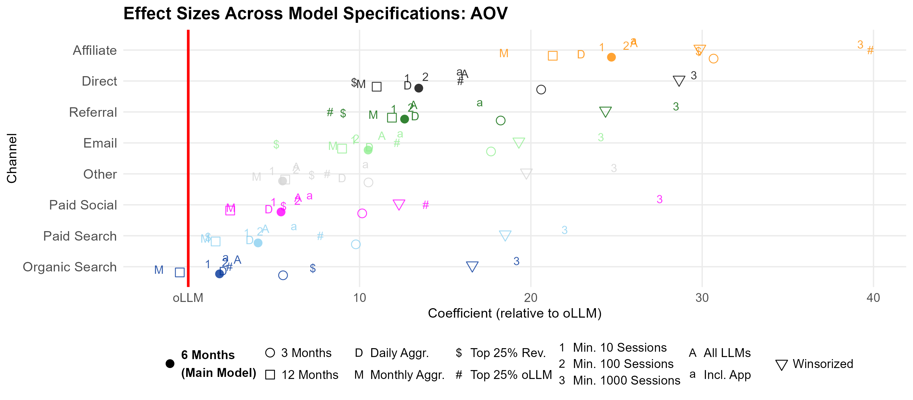
APPENDIX B · ROBUSTNESS
Average order value across all specifications
Takeaway: AOV shows the most variation in effect size, with two non-significant sign changes for organic search — but stays consistent with the main model (4 of 8 channels differ from oLLM).
Figure B.1. AOV by channel — all 12 specifications.
Maximilian Kaiser & Christian Schulze · ChatGPT Referrals to E-Commerce Websites · Marketing Science · organicllm.org
70
Notes:
The weakest-signal metric. The spread is wider here, but the qualitative conclusion (AOV barely separates oLLM from search-type channels) survives. Don't over-read AOV.

Slide 71
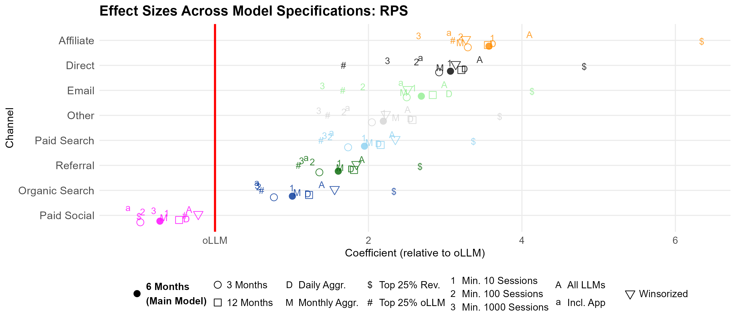
APPENDIX B · ROBUSTNESS
Revenue per session across all specifications
Takeaway: RPS is the most robust: oLLM stays significantly below organic search in all 12 specifications. The top-25%-revenue subset again shows the largest gaps.
Figure B.2. RPS by channel — all 12 specifications.
Maximilian Kaiser & Christian Schulze · ChatGPT Referrals to E-Commerce Websites · Marketing Science · organicllm.org
71
Notes:
The cleanest robustness story. Whatever you change, oLLM's revenue-per-session sits below organic search. The big-retailer subset widens the gap (large sites are least oLLM-optimized).

Slide 72
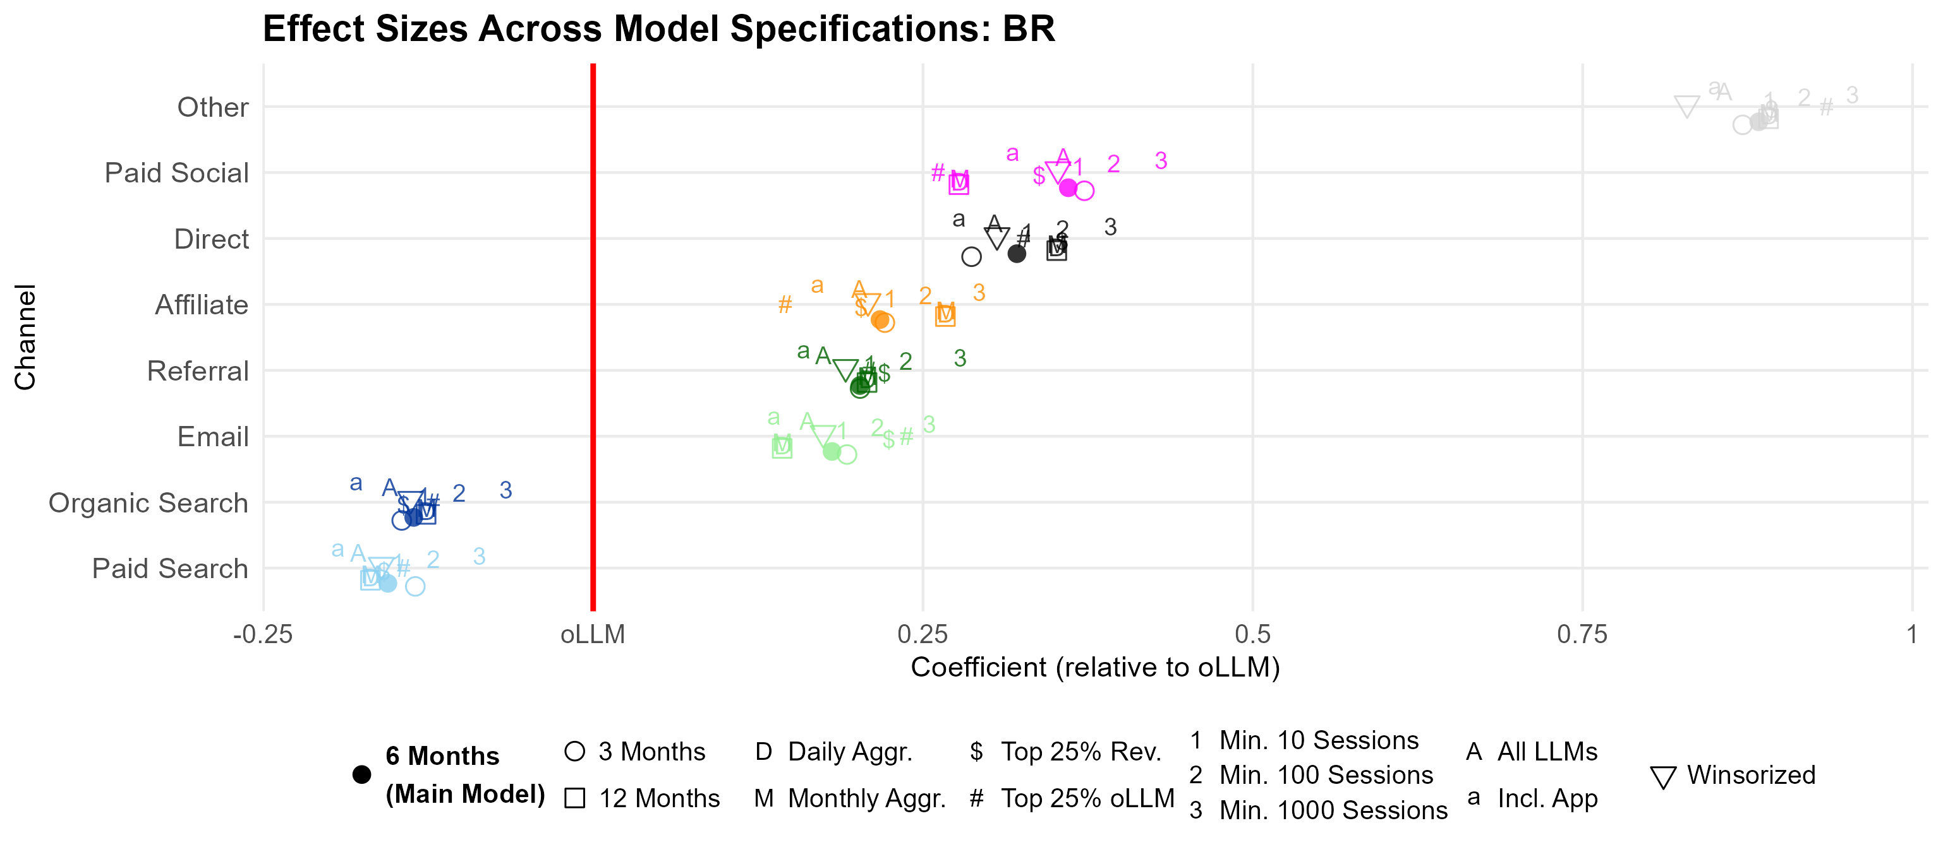
APPENDIX B · ROBUSTNESS
Bounce rate across all specifications
Takeaway: oLLM's favorable bounce rate is stable — better than most channels, with only search-type channels (engineered for low bounce) ahead.
Figure B.3. Bounce rate by channel — all 12 specifications.
Maximilian Kaiser & Christian Schulze · ChatGPT Referrals to E-Commerce Websites · Marketing Science · organicllm.org
72
Notes:
oLLM's one engagement strength holds up across specs: clicks from LLM links land on relevant pages. Only organic/paid search do better.

Slide 73
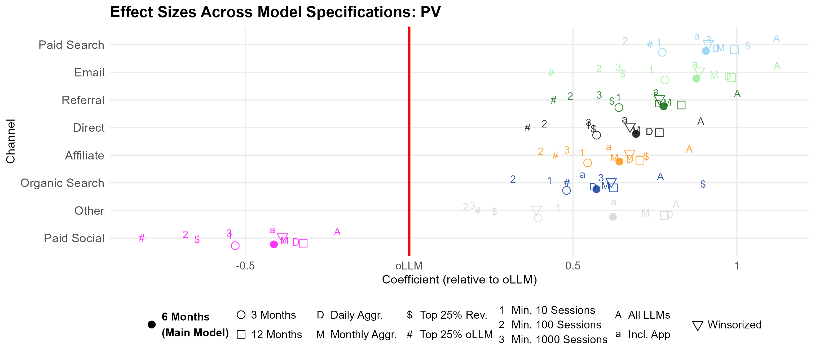
APPENDIX B · ROBUSTNESS
Page views across all specifications
Takeaway: Page views stay low for oLLM across specs — below every channel except paid social — consistent with highly task-oriented visits.
Figure B.4. Page views by channel — all 12 specifications.
Maximilian Kaiser & Christian Schulze · ChatGPT Referrals to E-Commerce Websites · Marketing Science · organicllm.org
73
Notes:
Shallow browsing is the stable signature: users arrive decided, view the target page, and don't explore. Pairs with the low bounce to suggest 'relevant but transactional.'

Slide 74
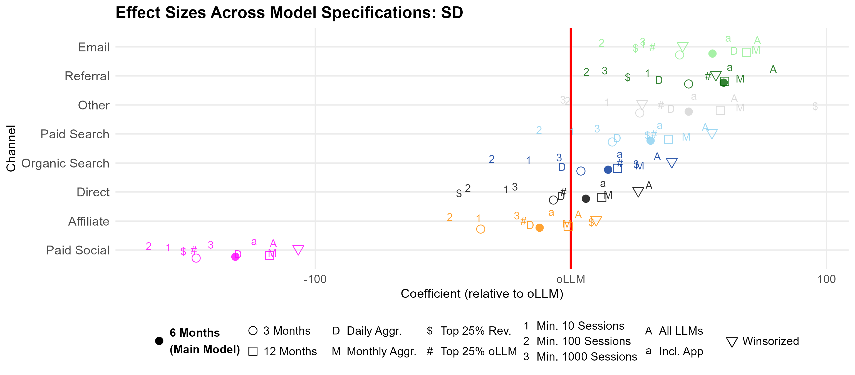
APPENDIX B · ROBUSTNESS
Session duration across all specifications
Takeaway: Session duration is mid-pack and stable — comparable to affiliate and direct, far above paid social.
Figure B.5. Session duration by channel — all 12 specifications.
Maximilian Kaiser & Christian Schulze · ChatGPT Referrals to E-Commerce Websites · Marketing Science · organicllm.org
74
Notes:
Completes the engagement triad. Duration is unremarkable (middle of the pack) and stable — the interesting engagement facts are the low bounce and low page-views, not duration.

Slide 75
APPENDIX B · ROBUSTNESS (REPRESENTATIVE TABLE)
A detailed robustness table: ChatGPT + all other LLMs
Channel (vs oLLM) | CR | AOV | RPS | BR | SD | PV
Affiliate | 0.647*** | 26.0*** | 4.10*** | 0.202*** | 2.91 | 0.855***
Paid Search | 0.392*** | 4.50 | 2.31*** | −0.178*** | 52.6*** | 1.12***
Other | 0.389*** | 6.31* | 2.51*** | 0.857*** | 63.9*** | 0.814***
Direct | 0.312*** | 16.1*** | 3.45*** | 0.305*** | 30.5*** | 0.890***
Email | 0.290*** | 11.3*** | 2.99*** | 0.162*** | 72.9*** | 1.12***
Referral | 0.239*** | 13.2*** | 1.91*** | 0.174*** | 79.1*** | 1.00***
Organic Search | 0.159*** | 2.88 | 1.39*** | −0.154*** | 33.8*** | 0.767***
Paid Social | −0.776*** | 6.42* | −0.339*** | 0.356*** | −116*** | −0.219***
Table B.9 (oLLM = ChatGPT + Perplexity + Gemini + Copilot + Deepseek + Grok; 408,342 obs). *** p<.01, ** p<.05, * p<.1. Eleven more robustness tables (B.1–B.12) in the paper.
Maximilian Kaiser & Christian Schulze · ChatGPT Referrals to E-Commerce Websites · Marketing Science · organicllm.org
75
Notes:
One representative example of the dozen detailed tables, chosen because it answers the most common methodological question: 'what if you include the other assistants?' Folding in Perplexity, Gemini, Copilot, Deepseek and Grok leaves every coefficient essentially unchanged from the ChatGPT-only main model. The other eleven tables (aggregation, thresholds, subsets, timeframes) are in the paper.

Slide 76
APPENDIX C · TEMPORAL SPECIFICATIONS
The four trend models, and what each assumes
Linear (logit) — a constant per-month change in log-odds; becomes near-exponential once converted back to a conversion rate. The optimistic case.
Centered linear — the same linear trend, re-centered; tames the apparent exponential and gives a cleaner intercept.
Gompertz — an asymmetric S-curve: fast early growth that decelerates. A saturating, conservative case.
Sigmoid — a symmetric logistic with a hard upper ceiling. The most conservative case.
Each enters as a channel × trend interaction, so every channel gets its own trajectory.
Why four?
Extrapolating a 12-month-old series is fragile. Bracketing it with an optimistic (linear) and conservative (Gompertz/Sigmoid) shape is an honesty device — conclusions only count where the four agree.
Maximilian Kaiser & Christian Schulze · ChatGPT Referrals to E-Commerce Websites · Marketing Science · organicllm.org
76
Notes:
These are the specifications behind the projection figures (18–20). The teaching point is methodological: when extrapolation is unavoidable, don't pick one curve — bracket the range. The linear model is the rosy scenario; Gompertz and Sigmoid are the disciplined ones; the paper only claims what holds across all four.

Slide 77
APPENDIX D · HETEROGENEITY (TABLE D.1)
By product complexity — the numbers behind Figs 21–23
Channel | CR: simple | CR: complex | AOV: simp. | AOV: comp. | RPS: simp. | RPS: comp.
Affiliate | 0.272* | 0.244** | 50.4*** | 64.6*** | 3.35*** | 3.61***
Paid Search | 0.198 | 0.056 | 40.5*** | 4.02 | 2.29*** | 1.09***
Other | 0.305** | 0.610*** | 18.5** | 6.58 | 2.36*** | 2.06***
Direct | 0.449*** | −0.345*** | 41.1*** | 24.5** | 3.53*** | 2.39***
Email | 0.199 | −0.317*** | 42.1*** | 14.6 | 2.89*** | 2.08***
Referral | 0.142 | −0.398*** | 39.5*** | 23.5** | 1.44*** | 1.62***
Organic Search | 0.287** | −0.374*** | 22.8*** | 4.66 | 1.28*** | 0.404***
Paid Social | −0.846*** | −1.31*** | 27.1*** | 17.3 | −0.192 | −1.26***
Table D.1. “simple/complex” = bottom/top quartile of category complexity. Coefficients vs oLLM; *** p<.01, ** p<.05, * p<.1. In the complex quartile, Direct/Email/Referral/Organic Search go negative — oLLM out-converts them.
Maximilian Kaiser & Christian Schulze · ChatGPT Referrals to E-Commerce Websites · Marketing Science · organicllm.org
77
Notes:
The hard numbers behind the complexity story. Read the 'CR: complex' column: Direct (−0.345), Email (−0.317), Referral (−0.398) and Organic Search (−0.374) all turn negative — meaning oLLM out-converts them on complex-product sites. On simple sites (the 'CR: simple' column) every channel beats oLLM. This is the most striking heterogeneity result in the paper.

Slide 78
APPENDIX D · HETEROGENEITY (TABLE D.2)
By technophile share — the numbers behind Figs 24–26
Channel | CR: low | CR: high | AOV: low | AOV: high | RPS: low | RPS: high
Affiliate | 0.855*** | 0.547*** | 14.9*** | 65.1*** | 4.18*** | 4.27***
Paid Search | 0.888*** | −0.076 | 5.49 | 17.9 | 2.44*** | 0.971***
Other | 0.573*** | −0.379*** | 7.01** | 10.9 | 2.63*** | 2.26***
Direct | 0.728*** | 0.174* | 11.6*** | 32.0 | 2.90*** | 3.31***
Email | 0.686*** | 0.272** | 1.05 | 36.1* | 3.01*** | 2.68***
Referral | 0.680*** | 0.214** | 13.5*** | 29.0 | 1.19*** | 1.50***
Organic Search | 0.630*** | −0.426*** | 4.73 | 20.8 | 1.43*** | 0.642**
Paid Social | −0.224 | −1.39*** | 3.29 | 21.9 | −0.119 | −1.61***
Table D.2. “low/high” = bottom/top quartile of visitor “technophile” share. In the high-technophile quartile, oLLM's CR exceeds Organic Search (−0.426) and Other (−0.379).
Maximilian Kaiser & Christian Schulze · ChatGPT Referrals to E-Commerce Websites · Marketing Science · organicllm.org
78
Notes:
Among technophile-heavy audiences (the 'CR: high' column), oLLM's conversion rate surpasses organic search (−0.426) — the channel it merely ties on average. But look at the AOV columns: the gaps WIDEN with proficiency (proficient users convert more, spend less). That rising-CR/falling-AOV signature is the mechanism the paper builds on.

Slide 79
APPENDIX D · HETEROGENEITY (TABLE D.3)
By visitor age — the numbers behind Figs 24–26
Channel | CR: younger | CR: older | AOV: yng. | AOV: old. | RPS: yng. | RPS: old.
Affiliate | −0.087 | 0.505** | 30.7*** | 12.6* | 2.11*** | 4.52***
Paid Search | 0.048 | 0.545** | 12.9*** | −12.5** | 1.99*** | 1.98***
Other | 0.090 | 0.165 | 20.9*** | −11.6* | 1.68*** | 3.21***
Direct | −0.035 | 0.531** | 26.1*** | −0.79 | 2.53*** | 4.55***
Email | −0.091 | 0.428* | 22.1*** | −5.17 | 3.07*** | 2.88***
Referral | 0.049 | 0.521** | 24.8*** | −6.22 | 1.77*** | 1.90***
Organic Search | −0.310*** | 0.291 | 15.9*** | −16.9*** | 0.918*** | 1.43***
Paid Social | −1.13*** | −0.283 | 8.36 | −7.26 | 0.544*** | −0.943***
Table D.3. “younger/older” = bottom/top quartile of average visitor age. On younger-visitor sites, oLLM out-converts Organic Search (−0.310) and Paid Social (−1.13).
Maximilian Kaiser & Christian Schulze · ChatGPT Referrals to E-Commerce Websites · Marketing Science · organicllm.org
79
Notes:
Age is the second proficiency proxy, and it tells the same story: on younger-skewing sites (the 'CR: younger' column), oLLM beats organic search (−0.310) and is statistically level with most other channels. The two proficiency proxies — technophile share and youth — agree, which is what makes the proficiency mechanism credible.

Slide 80
APPENDIX E · RECONCILIATION
Why our results may differ from the industry reports
Website cherry-picking: Seer's headline 15.9% oLLM CR is a single site. In our 973-site panel only 7 sites reach 6.7%+; the single highest is 26.0% (a clear outlier), the second-highest 12.9%.
ThoughtMetric's 6.7% average (100 sites) sits at the extreme tail of what we observe across a far broader sample.
Methodological upward bias: industry analyses often use daily aggregates — which badly distort a channel that is <0.2% of sessions (the median cell has zero transactions).
Filters like minimum-transaction thresholds quietly drop the zeros and inflate the reported oLLM conversion rate.
7 of 973
sites reach a 6.7%+ oLLM conversion rate
26.0%
the single highest — a clear outlier (2nd: 12.9%)
Maximilian Kaiser & Christian Schulze · ChatGPT Referrals to E-Commerce Websites · Marketing Science · organicllm.org
80
Notes:
This is the appendix's headline and it directly serves the deck's spine ('resist the hype'). The splashy case studies aren't fabricated — they're unrepresentative single sites plus aggregation choices that inflate a sparse channel. The gap between this paper's regression estimates and the model-free numbers (Section 3) is the same phenomenon: handle the sparsity properly and oLLM looks middling, not miraculous.

Slide 81
APPENDIX E · RECONCILIATION
Why our results may differ from research expectations
Platform & commercial-optimization gaps: only 2.1% of ChatGPT conversations involve a purchasable product, so retail features (full catalogs, live price/availability, reliable deep-links) aren't fully built out yet.
A website-investment coordination problem: weak outcomes depress retailers' incentive to optimize for oLLM, and limited investment sustains the weak outcomes — note large sites are not leading on oLLM.
Consumer adoption & verification: shopping via LLM is still nascent; users often verify a recommendation on search or the retailer's own site — which, under last-click, hands the conversion to that other channel.
Net: the engagement signature (low bounce, but shallow page-views and a declining AOV) fits early-stage, habit-forming, verification-heavy behavior — not a mature channel.
Maximilian Kaiser & Christian Schulze · ChatGPT Referrals to E-Commerce Websites · Marketing Science · organicllm.org
81
Notes:
Prior theory said LLMs SHOULD beat search (richer context, synthesis, conversation). They don't yet — and this slide gives the three grounded reasons: the platforms haven't built commerce out, retailers haven't optimized (a chicken-and-egg investment trap), and consumers are still learning and verifying. The last-click point matters: verification behavior actively transfers oLLM's credit to search/direct, so the measured numbers understate oLLM's true upper-funnel role.

Slide 82
APPENDIX F · FUTURE RESEARCH
Where this goes next
Mechanism & trajectory: is the rising-CR / falling-AOV pattern platform learning, consumer learning, or a shift in which products oLLM facilitates? This separates 'temporary growing pains' from 'structural limits.'
Friction & cross-platform: how much do in-platform shopping agents, specialized shopping LLMs, and on-site assistants (Amazon Rufus/Alexa) each reduce the leave-the-chat friction — and how do ChatGPT / Claude / Gemini / Perplexity differ?
Generative Engine Optimization (GEO): how can retailers raise LLM exposure, click-through, and conversion — and how do those stages interrelate along the funnel?
Moderators: competition intensity and brand strength (less ad bias, but possible prominence bias toward well-represented brands).
Market impact: paid LLM advertising (pLLM) and potential disruption to the retail-media ecosystem as shoppers bypass homepage advertising.
The big one to watch
Everything here is organic oLLM. Paid LLM advertising (pLLM) wasn't live during the study and could redefine the channel's economics — the single most important next question.
Maximilian Kaiser & Christian Schulze · ChatGPT Referrals to E-Commerce Websites · Marketing Science · organicllm.org
82
Notes:
Close the appendix on the open questions. The mechanism question (Appendix D's signature) is the obvious academic follow-up; GEO is the obvious practitioner one; and pLLM (paid ads inside the LLM) is the wildcard that could change everything. A good place to invite the audience's own research or strategy questions.

Slide 83
APPENDIX · FOR INSTRUCTORS
Key sources used in the framing
Industry signals cited: ThoughtMetric (2025), Seer Interactive (2025), Semrush (2025), Adobe (2025), SALT (2025).
Consumer & adoption evidence: Chatterji et al. (2025, 'How People Use ChatGPT'); Foroughi et al. (2025); Yang et al. (2025, Perplexity agents).
Channel & attribution: Berman (2018); Li & Kannan (2014); Haan, Wiesel & Pauwels (2016).
Platform monetization: Hermann, Puntoni & Schweidel (2025).
Full reference list: see the paper.
Maximilian Kaiser & Christian Schulze · ChatGPT Referrals to E-Commerce Websites · Marketing Science · organicllm.org
83
Notes:
An optional reference slide for instructors who want to follow up or assign readings. The industry reports are useful precisely because the paper reconciles its findings against them. Point students to the paper's bibliography for the complete list.

